Slide 1
NSDI Strategic Plan Update
FGDC Coordination Group Meeting
March 12, 2013

Slide 2
NSDI Strategic Plan – Purpose/Scope
  Purpose:
  Develop a concise, updated strategic plan to guide the Federal government’s activities toward the further development of the National Spatial Data Infrastructure (NSDI)
  Scope:
Validate and build consensus around a shared vision of the NSDI
Define the role of the Federal government to further the development of the NSDI
Collaboratively define the roles and relationships among Federal agencies and non-Federal partners and stakeholders
Identify 4-5 strategic goals, informed by the geospatial community, for the Federal government to pursue in the next 3 years
Develop follow-up implementation plans and performance measures to achieve these goals

Slide 3
NSDI Strategic Plan Drivers
OMB Circular A-16
GAO Report (GAO-13-94): Geospatial Information – OMB and Agencies Need to Make Coordination a Priority to Reduce Duplication (November 2012)
NGAC Paper: Toward A National Geospatial Strategy (December 2012)
Digital Government Strategy
Open Government Directive
Open Data Policy (2013)

Slide 4
GAO Recommendation (GAO-13-94)
…The Secretary of the Interior, as the FGDC chair should establish a time frame for creating and updating a strategic plan to improve coordination and reduce duplication, and create and implement the plan within the established time frame. The plan, at a minimum, should include:
  a vision statement for the NSDI
  outcome-oriented goals and objectives that address all aspects of the NSDI
  a description of how the goals and objectives are to be achieved, including a description of the resources needed to achieve the goals and objectives and how the FGDC is to work with other agencies to achieve them
  performance measures for achieving the stated goals; and
  external factors that could affect the achievement of the goals and objectives.

Slide 5
Timeline
Timeframe | Activity
Dec – Feb | Project Start-up
Feb – Sept * | Outreach to external partners, key individuals, professional meetings, social media, etc.
March 5 * | Strategic Visioning Workshop
March 7 * | NSDI Leaders Forum
Feb - March | Develop expanded outline of Strategic Plan
March 19 * | FGDC Steering Committee Meeting
April 3 * | NGAC Webinar Meeting
April-May | Develop initial draft Strategic Plan (v1)
June 11-12 * | NGAC Meeting (planned)
June 13 * | FGDC Steering Committee Meeting
June - July | Develop revised draft Strategic Plan (v2)
July – Aug * | Public Comment Period
Sept 10-11 * | NGAC Meeting (planned)
Sept 12 * | FGDC Steering Committee Meeting
Sept - Oct | Develop Final Review Draft Strategic Plan (v3)
Oct | NGAC Endorsement of Strategic Plan
Oct | FGDC Approval of Strategic Plan
Nov - Dec | Final review/approval of Strategic Plan
*Opportunities for public/partner input

Slide 6
Project Team and Partners
Roles and Responsibilities
Executive Sponsors | Anne Castle (DOI, FGDC Chair), Lisa Schlosser (OMB, FGDC Vice-Chair), Dan Cotter (DHS), Ivan DeLoatch (FGDC)
Project Core Team | John Mahoney (FGDC), Ken Shaffer (FGDC), Jerry Johnston (DOI rep), Steve Lewis (DOT rep), Tony LaVoi (DOC rep), Lew Summers (DHS/Coordination Group Vice Chair), Tricia Gibbons (Facilitator, LEAD Alliance)
FGDC Executive Committee | Serve as key consultation group for the strategic planning process on behalf of the FGDC Steering Committee; provide direction and validate findings
FGDC Coordination Group | Provide interagency coordination & communication; provide ongoing input to the planning process and the plan
National Geospatial Advisory Committee | Validate approach, provide input on context setting and strategic direction; provide feedback on the work of the writing team. Gather input from NGAC member organizations.
Non-Federal Partners | Provide input and feedback, validate approach

Slide 7

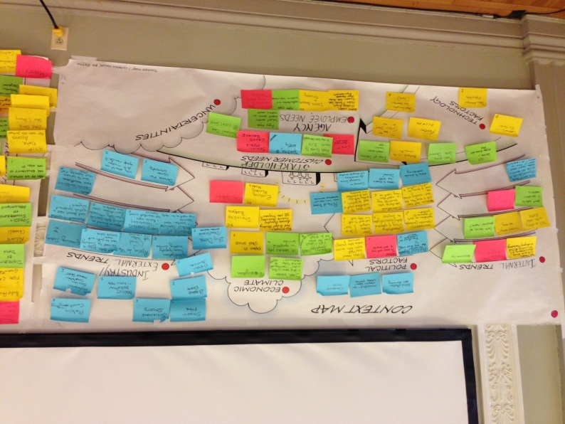
NSDI Strategic Visioning Workshop
Tuesday, March 5, 8:30 – 5:00, South Interior Auditorium
Purpose
Begin discussions focusing on the role and contributions of the federal geospatial community in furthering the development of the NSDI
Participation
Key Federal geospatial leaders and managers
35 participants representing 22 Federal agencies and offices

Slide 8
NSDI Strategic Visioning Workshop
Key Activities:
Conducted an environmental scan; discussed trends and factors impacting the geospatial community
Conducted a SPOT analysis focusing on internal strengths and problems and future threats and opportunities
Discussed the vision of the NSDI
Began discussions about the role of the federal geospatial community
Identified potential focus areas for the federal community
Initial Results
High level of engagement and diversity of interest
Many excellent ideas and suggestions
Results are being compiled and will be posted on the FGDC website
Still discussing and defining the role of the federal geospatial community – external perspectives on this issue will be helpful

Slide 9
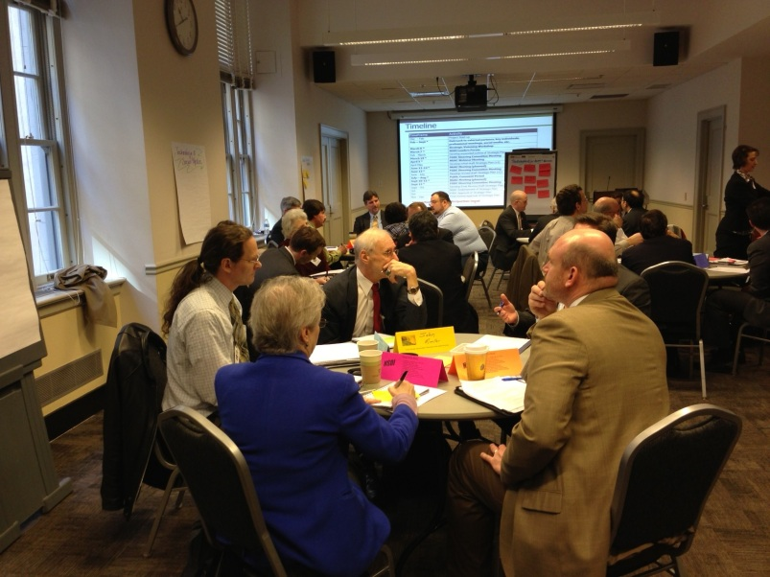

NSDI Leaders Forum
Thursday, March 7, 10:00 – 12:30, Interior Department
Purpose
Begin discussions focusing on the role and contributions of the federal geospatial community in furthering the development of the NSDI
Participation
Leaders of key geospatial organizations and professional associations
18 participants representing 16 professional associations and geospatial organizations

Slide 10
NSDI Leaders Forum
Invitees/Organizations:
American Association of State Highway and Transportation Officials (AASHTO) | National Emergency Number Association (NENA)
American Society of Photogrammetry and Remote Sensing (ASPRS) | National Information Sharing Consortium
Association of American Geographers (AAG) | NRC Mapping Science Committee
Cartography and Geographic Information Society (CAGIS) | NRC Transportation Research Board
Coalition of Geospatial Organizations (COGO) | National Society of Professional Surveyors (NSPS)
Geospatial Information & Technology Association (GITA) | National States Geographic Information Council (NSGIC)
GIS Certification Institute (GISCI) | Open Geospatial Consortium (OGC)
International Association of Assessing Officers (IAAO) | University Consortium for Geographic Information Science (UCGIS)
Management Association for Private Photogrammetric Surveyors (MAPPS) | Urban and Regional Information Systems Association (URISA)
National Alliance for Public Safety GIS Foundation | U.S. Geospatial Intelligence Foundation (USGIF)
National Association of Counties (NACo) | Western Governors' Association (WGA)
National Association of State Chief Information Officers (NASCIO)

Slide 11
NSDI Leaders Forum
Key Activities:
Share background and approach for developing the strategic plan
Solicit perspectives and build common understandings of the current state - including trends, conditions, challenges and opportunities
Share ideas for roles and responsibilities of the different sectors involved in geospatial activities
Encourage support and involvement of associations/organizations
Initial Results:
High level of engagement and interest
Excellent ideas, suggestions, and discussions
Results are being compiled and will be posted on the FGDC website
Group expressed desire for continued involvement in the strategic planning process – requested follow-up meetings

Slide 12
Next Steps
Compile and distribute results from NSDI Workshop and Forum meetings. Post materials on FGDC website.
Continue discussions with FGDC Executive Committee and Coordination Group
Engage with the NGAC
Solicit additional ideas and feedback from the non-federal geospatial community

Slide 13
How you can help…
Discuss with your colleagues, partners, and organizations
Offer input through meetings, professional organizations, online discussions
Provide feedback on the plan and results
For more information or to provide input, visit:
www.fgdc.gov/nsdi-plan

Slide 14
Background/Resources
Previous NSDI Strategic Plans
NSDI Future Directions Initiative (2004)
A Strategy for the NSDI (1997)
Plan for the National Spatial Data Infrastructure (1994)
Recent FGDC Strategic Activities
Geospatial Platform Business Plan (2012)
Geospatial Platform Modernization Roadmap (2011)
OMB Circular A-16 Supplemental Guidance (2010)
Geospatial LoB Common Solutions/Target Architecture (2006)
Federal Enterprise Architecture Geospatial Profile (2006)

Slide 15
Comments
&
Questions
www.fgdc.gov/nsdi-plan

