Slide 1
National Digital Orthoimagery Program (NDOP)
Update to Coordination Group
August 13, 2013
Coordination Group Meeting
Chair: Chris Barnard
Department of Homeland Security
robert.barnard@hq.dhs.gov

Slide 2
Introduction
The Purpose of the NDOP Subcommittee:
  The NDOP Subcommittee is responsible for developing, promoting, and executing a national strategy for the acquisition or development of orthoimagery data for Federal agencies while creating and utilizing partnerships with State, local, tribal, and private organizations.
  Member agencies: FSA, USGS, NGA, NRCS, FS, BLM, FEMA, NOAA, NSGIC, NPS, EPA, Census Bureau
Chair rotates annually with the transition after the fall meeting
  Current Chair: Chris Barnard, DHS

Slide 3
Recent Meetings
The NDOP Steering Committee met May 14-16, 2013 in Washington, DC
The topics discussed at this meeting included:
  NAIP 2013 Contract
  FAA Presentation on the Airports GIS Program
  Landsat 8
  ADS80/100 Quality Assessment Plan
  Alaska Mapping Initiative
  3D Elevation Program Update
  A-16 Theme Discussion
  Agency and Subgroup Reports
Notes:
Discuss NAIP in next slides
FAA – a 15 year program to collect GIS data for all airports. They need leaf-on imagery. USGS is putting airports and runways on their topographic maps and would like to work with the FAA in this process.
Landsat 8 (formerly known as the LDCM – Landsat Data Continuity Mission) was launched on February 11, 2013. The first images were sent back March 18. The new data is geometrically consistent with historic data.
ADS80/100 Quality Assessment Plan – located at Stennis Space Center. Program is based on absolute radiometry in order to reduce variability.
Alaska Mapping Initiative – an Alaska Mapping Conference was held February 18-22, 2013 in Anchorage. The Alaska Mapping Executive Committee chaired by Anne Castle met. Agency IfSAR proposed contributions were submitted. They also reviewed costs and requirements for NOAA to complete statewide GRAV-D and shoreline mapping.
An update to 3DEP was presented.
Vraga and Hall presented on developments in A-16 implementation – focused on themes and need to identify NGDAs for Imagery
At every meeting, agencies report on their on-going imagery and related programs. Also the subgroups: Program Management, and Technology Management gave presentations.

Slide 4
Recent Meetings
Some of the outcomes arising from this meeting include the following actions:
  The NDOP is investigating how we can use the functionality of the Geospatial Platform Marketplace in the future to potentially replace the current Project Tracking System hosted by FEMA
  Action to agencies to identify datasets to include in the A-16 Imagery theme
Notes:
Geo Plat – looking for possible assistance with administration of theme and support for coordination efforts – project tracking, acquisition tracking, data delivery
Initial discussions here – warning that Theme leads will need to visit with agencies; concern for Satellite NGDAs

Slide 5
Recent Projects
NAIP 2012-2014 Acquisition Plan
  Funding agreement signed last year by FSA and their partners, NRCS, USFS, and DOI
  Changes to the new 3-year plan include:
    Capability to add AK and HI/Pacific Basin/Puerto Rico to acquisition plan (funding contingent)
    Option for 1/2m buy-up
    4-band is now the standard product
    Option for hyper-spectral (8-band, satellite)
    CCMs may be discontinued
Notes:
5-year IDIQ awarded to three prime contractors: North West Geomatics; Premier Geospatial; Surdex Corporation – fewer contractors, fewer administrative difficulties
FY 12 - 22 states awarded in two phases
DOQQ pricing history – average price per DOQQ has gone down in last two years significantly – vendors have been streamlining their practices
change coming: Compressed County Mosaics (CCM) – FSA no longer has a business need for the CCM – the CCM will be discontinued as standard deliverable after 2013 season
Changes under consideration:
Compressed QQs – 10:1 JPEG 2000 quarter quads produced at APFO after delivery of full resolution QQs
Early Access image service –
Prefer access/delivery in less than 10 days for disaster management, acreage reporting, and program compliance in order to identify a crop before harvest
Indications from several vendors to host interim web services with pre-processed imagery – not color balanced nor orthorectified
Potential Pilot Project planned for 2013 – will ask vendors first for feasible solutions
Partners – FSA is looking for cost sharing for such a service

Slide 6
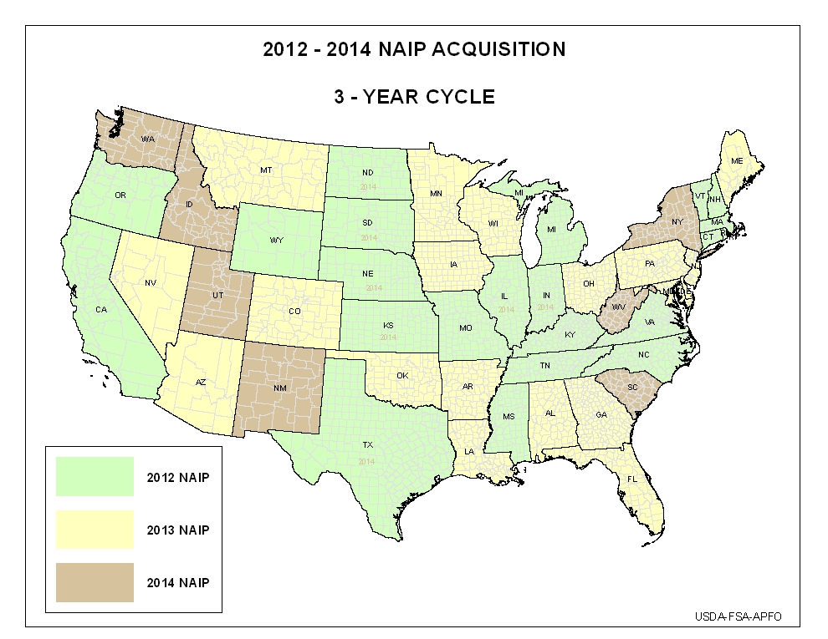
Notes:
Original plan in FY 12

Slide 7
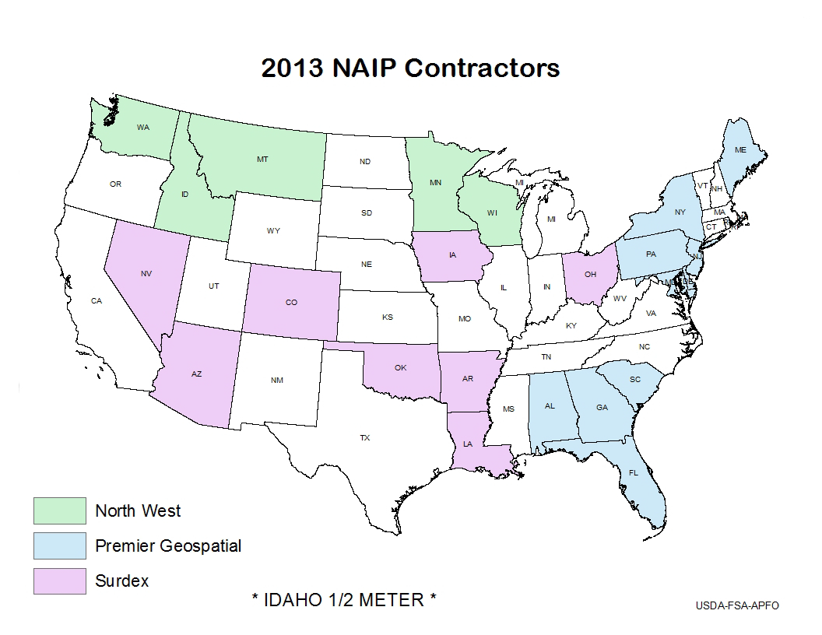
2013 Actual NAIP Acquisition

Slide 8
Recent Projects, Cont’d.
Urban Areas
  Program sponsored by NGA in partnership with USGS
  1-foot resolution, leaf-off imagery
  Hope to continue to maintain a 3-year refresh cycle for all of the urban areas with a 2-year cycle for the top 50 cities
Notes:
NGA program run in Partnership with USGS
Successful with many partners, large areas, high dollar leveraging totals
Funding has been reduced over last several years; more reductions coming
Wants to stay w/ 3 year refresh cycle – depends on funding and partners

Slide 9
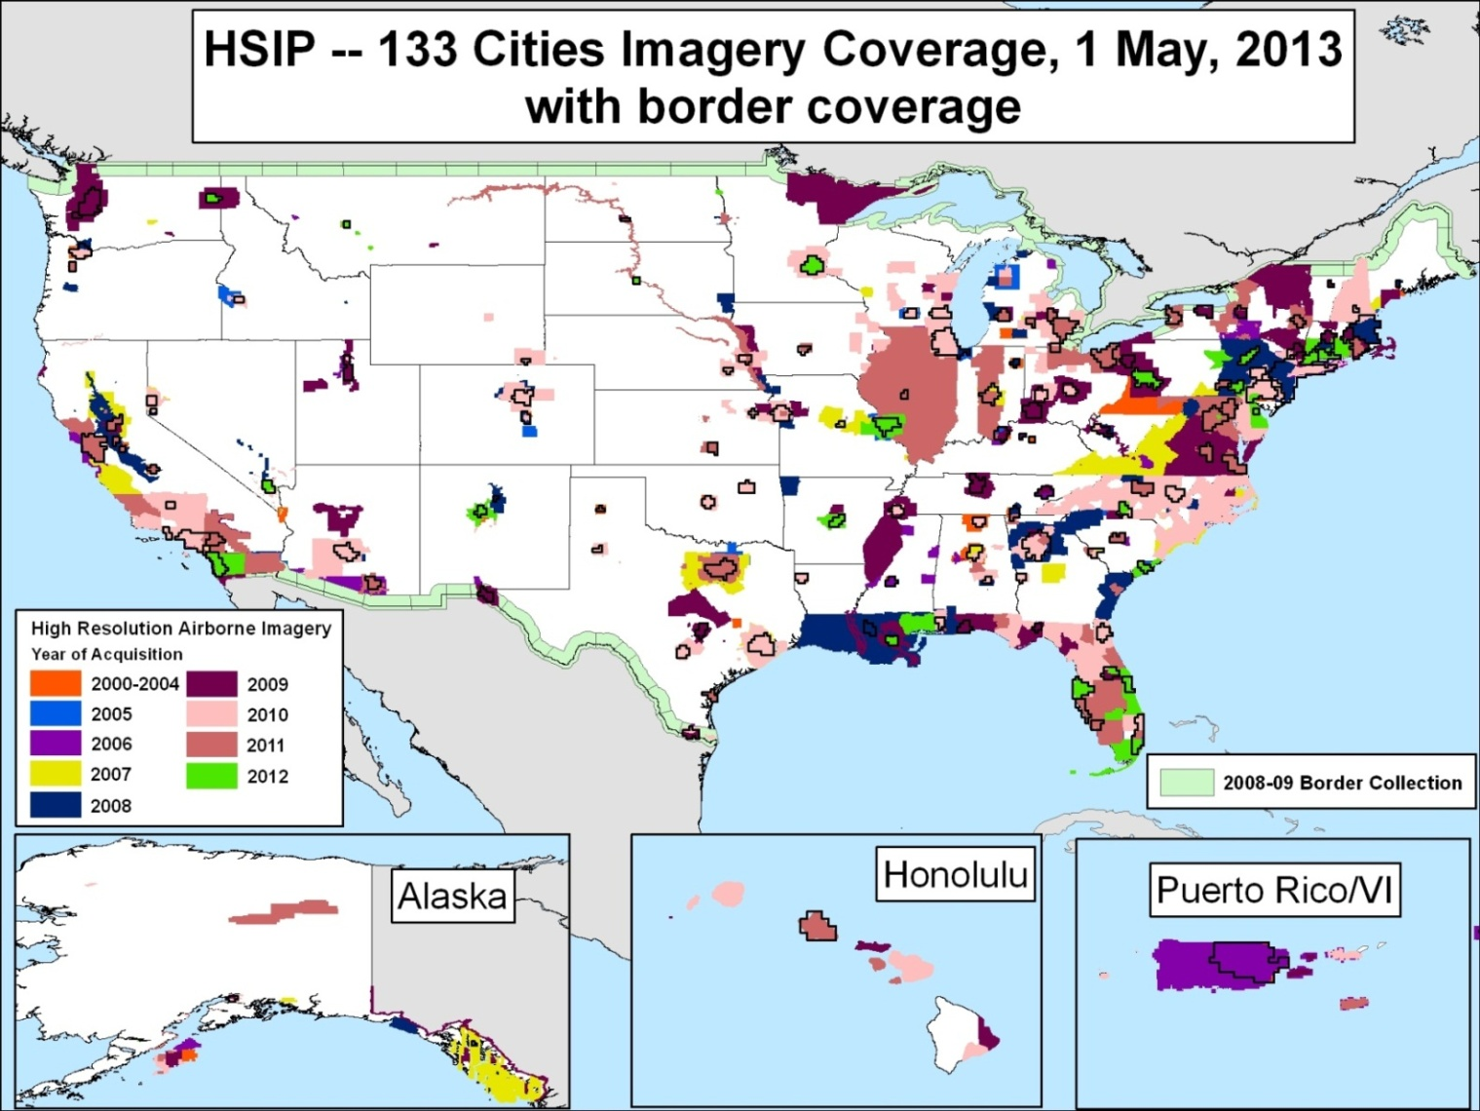
FY 12 Imagery Projects

Slide 10
Recent Projects, Cont’d.
Update of the NDOP Website – we extensively updated the site to make sure that all information is current
http://www.ndop.gov/
Notes:
Perhaps GP can help us here

Slide 11
Next Steps
In the coming months, the NDOP Subcommittee hopes to:
  Discuss how to better align imagery and elevation data acquisition investments in Alaska
  Establish new 3-year multi-agency agreement (2015-2017) for cooperative funding of NAIP

Slide 12
Next Meeting
The next meeting of the NDOP Subcommittee will be held in November, 2013 in Salt Lake City, UT.
Some of the topics to be discussed at the next meeting include:
  NAIP Update
  High Resolution Program Update
  Agency Updates and Subcommittee Reports
Notes:
Face to Face depends on Sequestration

Slide 13
Questions?
Shirley Hall, USDA-FSA
Shirley.Hall@wdc.usda.gov
Dick Vraga, USGS
rsvraga@usgs.gov

