Slide 1
National Geospatial Advisory Committee
Nomination & Appointment Process
Webinar Briefing
Wednesday, August 8, 2018
3:00 – 4:00 pm EDT

Slide 2
Agenda
Welcome/NGAC Background | Ivan DeLoatch, FGDC Executive Director
NGAC Activities | Julie Sweetkind-Singer, NGAC Chair
2018 NGAC Nominations/ Appointments Process | John Mahoney, FGDC
Questions/Discussion | Group

Slide 3
FGDC Structure
Chair: DOI
Vice-Chair: OMB
DFO*
National Geospatial Advisory Committee
- Per OMB Policy
- Departmental
- Executives (SAOGIs)
- Decision Making Body
- ExCom Assists Chair
Steering Committee
Executive Committee
FGDC Office
of the Secretariat
- Hosted in the USGS
- Bureaus/Agencies
- Program Leads
- Business Execution
Coordination Group
Subcommittees &
Working Groups
- Data Themes
- Cross-cutting Issues
*Reports through the Designated Federal Officer (DFO), Executive Director of the FGDC OS

Slide 4
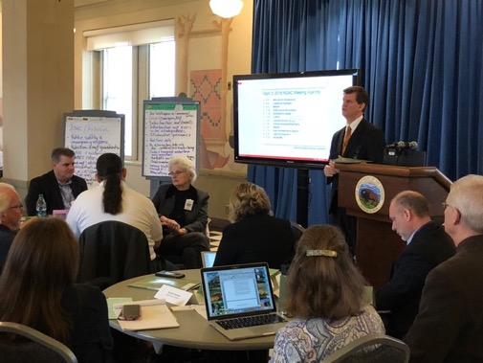
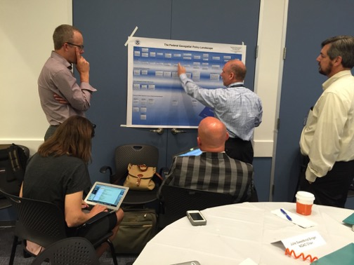
National Geospatial Advisory Committee
Federal Advisory Committee, sponsored by DOI, providing advice & recommendations on national geospatial policy issues to FGDC.
Balanced membership:
  14 members from non-governmental organizations (private sector, non-profits, academia)
  14 members from governmental organizations (federal, state, local, county, tribal, regional)
A primary means to collaborate with FGDC’s wide network of partners & stakeholders.

Slide 5
National Geospatial Advisory Committee
Ms. Julie Sweetkind-Singer (Chair) Stanford University | Mr. Stuart Davis State of Ohio | Dr. Carl Reed Carl Reed and Associates, LLC
Mr. Keith Masback (Vice-Chair) U.S. Geospatial Intelligence Foundation | Mr. Matthew Gentile Deloitte Financial Advisory Services, LLP | Ms. Amber Reynolds City of Topeka, KS
Dr. David Alexander Department of Homeland Security | Mr. Frank Harjo Muscogee (Creek) Nation | Dr. Douglas Richardson Association of American Geographers
Mr. Frank Avila National Geospatial-Intelligence Agency | Mr. Xavier Irias East Bay Municipal Utility District | Mr. Cy Smith State of Oregon
Dr. Sarah Battersby Tableau Software | Ms. Roberta Lenczowski Roberta E. Lenczowski Consulting, LLC | Ms. Rebecca Somers Somers-St. Claire GIS Consultants
Mr. Talbot Brooks Delta State University | Mr. Roger Mitchell MDA Information Systems, Inc. | Ms. Jennie Stapp State of Montana
Mr. Gar Clarke State of New Mexico | Ms. Rebecca Moore Google, Inc. | Dr. Harvey Thorleifson Minnesota Geological Survey
Mr. Garet Couch National Tribal GIS Center | Mr. Kevin Pomfret Centre for Spatial Law and Policy | Mr. Jason Warzinik Boone County (MO) Fire District
Ms. Patricia Cummens ESRI | Dr. Laxmi Ramasubramanian Hunter College, City University of NY | Dr. May Yuan University of Texas – Dallas
August 2018

Slide 6
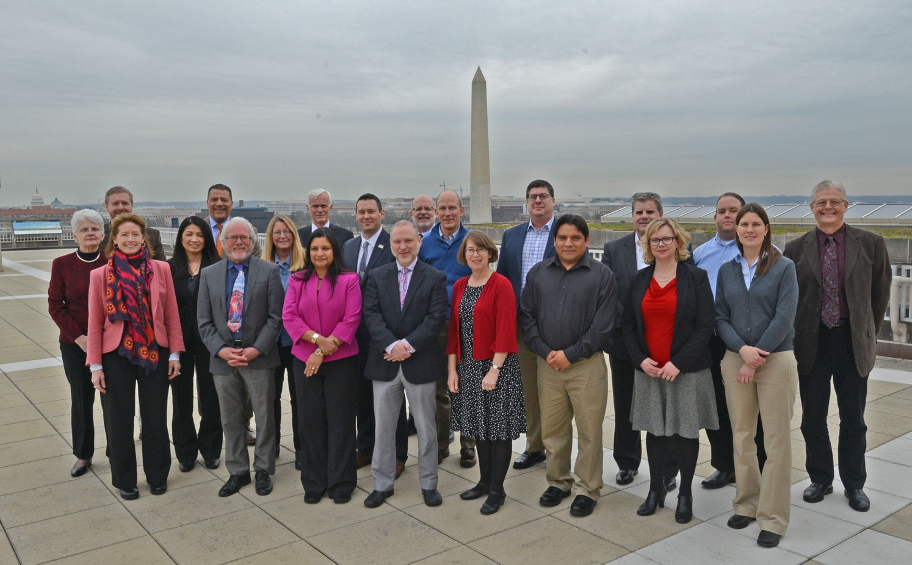

Slide 7
NGAC Purpose
The Committee will provide advice and recommendations related to management of Federal and national geospatial programs, development of the NSDI, and implementation of OMB Circular A-16 and Executive Order 12906. The Committee will review and comment on geospatial policy and management issues and provide a forum to convey views representative of non-Federal stakeholders in the geospatial community.
The duties of the Committee are solely advisory. The Committee provides counsel and advice to the Secretary of the Interior through the Designated Federal Officer (DFO).
*NGAC Charter

Slide 8
NGAC Mission
To provide strategies regarding the creation, management and dissemination of cohesive geospatial data, information and knowledge to enable commercial, academic, and nonprofit organizations and all levels of government to more effectively:
  empower and serve the public
  protect our homeland
  foster economic growth
  advance science
  manage our resources
  prepare for and respond to emergencies
  govern our nation
* Adopted by NGAC, June 2008

Slide 9
NGAC Operations
Sponsored by Interior Department – administrative support provided by FGDC Secretariat
Meets 3-4 times per year
Public meetings – including opportunities for public comment/input
Subcommittees meet between committee meetings to develop materials for consideration by full committee
More information, including all meeting minutes and materials, posted at: www.fgdc.gov/ngac

Slide 10
NGAC Activities

Slide 11
NGAC Activities
The NGAC engages in multiple activities, including:
Developing papers/products addressing FGDC guidance topics
Providing feedback on initiatives and management issues
Providing advice and recommendations on Federal geospatial programs
Spotlight sessions to educate geospatial community on emerging topics
Discussing collaborative approaches to cross-sector and intergovernmental issues

Slide 12
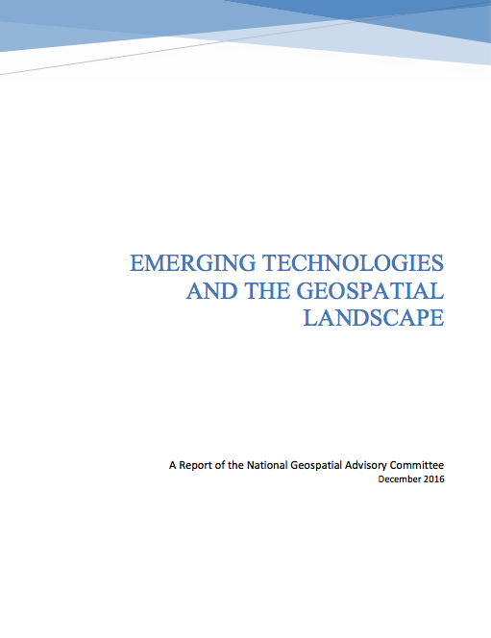
NGAC Papers/Products
Changing Geospatial Landscape
Emerging Technologies

Slide 13
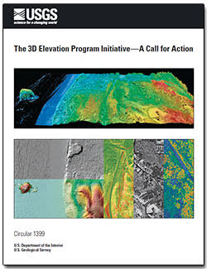
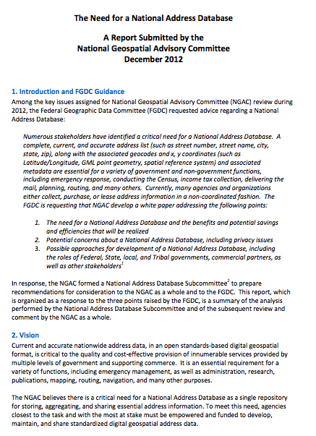
Advice on Federal Programs
3D Elevation Program
National Address Database

Slide 14
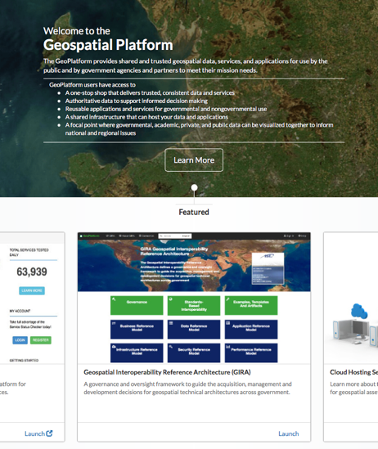
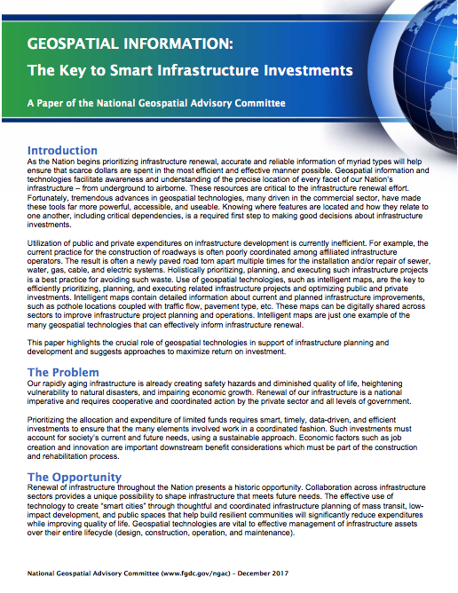
Input on Key Initiatives
NSDI Strategic Plan
Geospatial Platform
Geospatial Technology &
Infrastructure

Slide 15
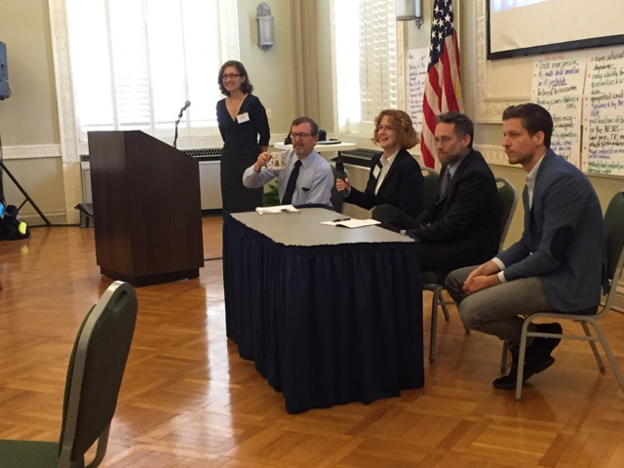
Spotlight Sessions
Panel discussions highlighting key geospatial policy issues and exploring possible roles for FGDC/NGAC
Past Spotlight Sessions:
  Data Sharing
  Workforce Development
  Geospatial Privacy
  Crowdsourced Data
  Emerging Technologies
  Data as a Service

Slide 16
Current NGAC Subcommittee Activities
Geospatial Technology & Infrastructure
Task: Develop products describing how geospatial technology, tools, and information can help drive smart decision-making on infrastructure priorities and investments
Landsat Advisory Group
Task: Examine cost sharing options for Landsat data
Data as a Service
Task: Provide advice and recommendations addressing current and future needs for data as services from Federal data repositories (GeoPlatform, Data.gov, etc.)
Cultural & Historical Geospatial Resources
Task: Provide advice and feedback on policies and procedures to protect geospatial data assets that have cultural and historical significance.

Slide 17
Upcoming Activities
NGAC Subcommittees:
Developing products/papers to address FGDC guidance to the NGAC
Next NGAC Meetings:
September 5-6, 2018 (National Conservation Training Center, Shepherdstown, WV)
December 2018 Webinar Meeting (date TBD)

Slide 18
2018 Nominations/
Appointments Process

Slide 19
NGAC Nominations
Call for Nominations issued on July 13, 2018
Nominations due August 27, 2018
Nominations received through this Call for Nominations may be used to fill vacancies that will become available in 2018 and 2019.
Nominations will be evaluated by interagency review panel
Appointments to the NGAC are made by the Secretary of the Interior
Next appointments – December 2018

Slide 20
NGAC Appointments
NGAC members are selected to achieve a balanced representation of the perspectives of the various stakeholders or communities of interest involved in national geospatial activities and the development of the NSDI.
Selection of members includes consideration of geographic balance.
NGAC members serve staggered terms to promote continuity.
Appointments are for 3 year terms, and members may not serve more than 2 consecutive terms.
Members are reimbursed, per Federal travel regulations, for travel and per diem expenses while attending NGAC meetings.

Slide 21
Nomination Requirements
Nominations may come from employers, associations, professional organizations, or other geospatial organizations.
Nominations should include a resume providing an adequate description of the nominee’s qualifications, including information that would enable the Department of the Interior to make an informed decision regarding meeting the membership requirements of the Committee and permit the Department of the Interior to contact a potential member.
Nominees are strongly encouraged to include supporting letters from constituents, trade associations, alliances, and/or other organizations that indicate the support by a meaningful constituency for the nominee.
Additional information about the nomination process is available on the NGAC website at www.fgdc.gov/ngac

Slide 22
NGAC Appointments Status
Non-Governmental (14) | Governmental (13)
Private Sector (9) Sarah Battersby Matthew Gentile* Roger Mitchell* Rebecca Moore Carl Reed Pat Cummens Roberta Lenczowski Kevin Pomfret Rebecca Somers | State (5) Gar Clarke Stuart Davis Cy Smith Jennie Stapp Harvey Thorleifson
 | County (1) Jason Warzinik
Academia (3) Laxmi Ramasubramanian May Yuan Julie Sweetkind-Singer | Federal (2) David Alexander Frank Avila
 | Regional (1) Xavier Irias
Non-Profit (2) Douglas Richardson* Keith Masback | City/Municipal (1) Amber Reynolds
 | Tribal (2) Frank Harjo* Garet Couch
 | Emergency Services (1) Talbot Brooks*
Current Members
(Terms expire December 2018)
Current Members
(Terms expire December 2019)
* Asterisk denotes Members completing second term on NGAC in December 2018. Per the NGAC Charter, cannot be appointed to third consecutive term.
August 2018

Slide 23
2018 NGAC Appointments Timeline
Date | Action
May/June/July, ongoing | Outreach to partners about nominations/appointments
July 13 | Call for Nominations issued (open for 45 days)
August 8 | Informational Webinar – provide information to stakeholder/partner organizations, interested parties
August 27 | Nominations due
September/October | Review Panel – evaluation of nominations
October | Appointments package submitted to Office of Secretary of Interior
October-December | Appointments reviewed & approved
Dec. 31, 2018 (est.) | New appointments take effect
Note – Nominations received through this Call for Nominations may be used to fill vacancies that will become available in 2018 and 2019.
Additional information is posted at: www.fgdc.gov/ngac
8-8-18

Slide 24
Draft Review Panel Criteria
General Criteria:
Committee membership should reflect a balanced representation of the viewpoints of the various interests involved in national geospatial activities and the development of the NSDI
Committee membership should reflect diversity, geographic balance, and experience with multiple sectors of the geospatial community
Specific Criteria:
Members should effectively represent a constituency or community of interest
Members should have a record of significant accomplishment and be recognized and respected within their fields
Members should be able to speak authoritatively on geospatial matters and communicate complex issues to a broad audience in a simple manner
Members should have a collaborative, consensus-building approach

Slide 25
QUESTIONS?
Ivan DeLoatch 703-648-5752 ideloatch@usgs.gov | John Mahoney 206-220-4621 jmahoney@usgs.gov

