Slide 1
Advancing Geographic Place-Based Understanding ^{for} Decision-Making
US National Spatial Data Infrastructure
Vietnam Delegation Briefing
Ivan DeLoatch
Executive Director
Federal Geographic Data Committee
Notes:
Ivan DeLoatch

Slide 2
Linking Geographic Information
USGS, CSS, FGDC Org Chart and Intro
Core Science Systems
Mission Area
Notes:
The FGDC Office of the Secretariat, is administered by the USGS

Slide 3
Linking Geographic Information
Associate Director -
Core Science Systems
Core Science Systems
Kevin Gallagher
703-648-5747
kgallagher@usgs.gov
John Wesley Powell Center
Federal Geographic Data Committee (FGDC)
National Geospatial Program
National Cooperative Geologic Mapping Program (NCGMP)
National Geological & Geophysical Data Preservation Program & National Laboratories
Core Science Analytics and Libraries
Ivan Deloatch,
FGDC Executive Director
Mike Tischler
National Geospatial Technical Operations Center (NGTOC)
National Ice Core Laboratory (NICL)
Core Research Center (CRC)
Notes:
FGDC and the National Map reside within the Core Science Systems mission area.

Slide 4
Linking Geographic Information
A-16 FGDC Chair
-Geospatial Information
Officer
-DOI SAOGI
-Managing Partner
of GeoPlatform
Delegated FGDC Chair
Notes:
Alignment within the department of interior

Slide 5
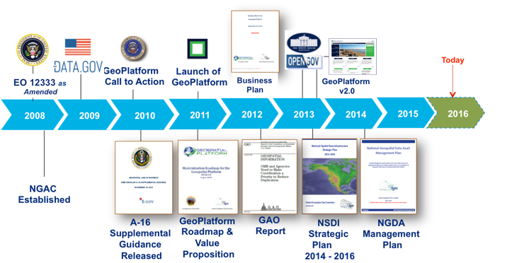
Linking Geographic Information
Our Journey Advancing Geographic Place-Based Understanding for the Nation
National Spatial Data Infrastructure
1990
The United States Federal Geographic Data Committee (FGDC) was Established to Coordinate the Nations Geographic Information and Federal Spatial Data Activities
Notes:
The FGDC was established to coordinate the nations Geographic information and federal spatial data activities.
Since 2008 we have have worked to optimize our capabilities using architecture principles to establish services under a line of business framework. Over the past year we have made the most significant progress using the LOB concept.

Slide 6
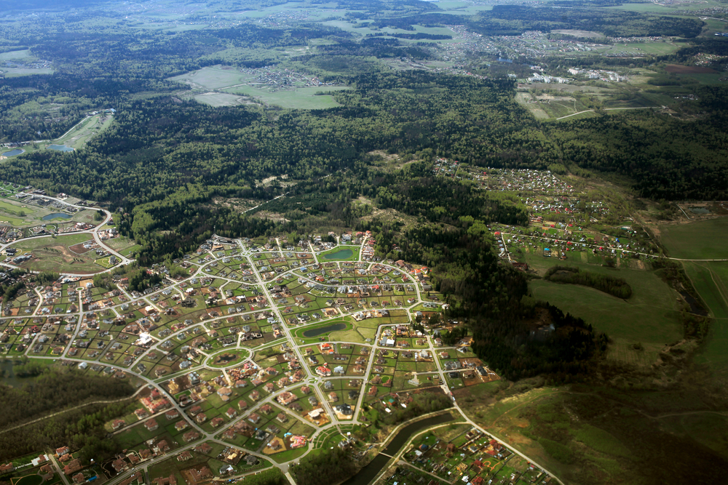
Advancing the Use of Geographic Information for the Nation
Partnerships
Policies
Standards
NSDI Framework for Linking Geographic Information
Procedures
Data
Technology
National Spatial Data Infrastructure
The NSDI Provides a framework of polices, standards, procedures, data and technology to support the effective coordination and sharing of spatial information among a community of stakeholders.
Notes:
Like other infrastructures in the finance, utility and transportation sector we have an infrastructure and framework to support the use of geographic information is needed.
The US NSDI Framework components include:
Partnerships for coordination and collaboration
Policies, procedures, and Standards for data sharing, management and interoperability
Data and Technology services to support access and use of geospatial information
The framework provides the foundational components that have helped our nation advance the use of geographic information and spatial services. I will provide more detail on the following slides.

Slide 7
Linking Geographic Information
NSDI Partnerships & Collaboration
Federal
State & Local
Tribal
Private & Professional
Academia
International
Notes:
The FGDC includes at its core a vision for a spatial data infrastructure that supports local to global interests.
To achieve that vision we must have effective partnerships thus it is the first component in the NSDI Framework
We have built a coalition that includes Federal partners from our 32 Federal organizations, State & Local leaders from our 50 states and territories, Tribal governments, the private sector and academic community and we collaborate in the development of regional and global SDI’s.

Slide 8
Partnerships and Governance
STEERING COMMITTEE
EXECUTIVE COMMITTEE
NATIONAL GEOSPATIAL ADVISORY COMMITTEE
OFFICE OF THE SECRETARIAT
COORDINATION GROUP
Strategic Direction
THEMATIC SUBCOMMITTEES
Address
Cadastre
Non-Federal Advisory
Cultural Resources
3D Nation Elevation
Geodetic Control
Geologic Data
Homeland Infrastructure Foundation –Level Data
Federal Advisory
Marine and Coastal Spatial Data
National Digital Orthimagery Program
Spatial Water Data
Transportation
Address Specific Geospatial Issues
Vegetation
Wetlands
UN Global Geospatial Information Management
Users
/Historical Data
Metadata
Standards
Architecture & Technology
National Boundaries
CROSSCUTTING WORKING GROUPS
FOUNDATIONAL COMPONENTS
PARTNERSHIPS
POLICIES
PROCEDURES
STANDARDS
DATA
TECHNOLOGY
National Spatial Data Infrastructure
Advancing Geospatial Capabilities for the Nation
Notes:
We have evolved overtime into a 4 tier governance structure to develop and implement the NSDI
32 Federal organizations makeup the Steering Committee that sets high-level strategic direction for the FGDC and is led by a subset of Executive Committee members selected from agencies with the largest investments.
Non-Federal Constituents from Public, Private, and academia provide advice through the National Geospatial Advisory Committee
The Coordination Group advises on the day-to-day business of the FGDC
Agency Led Subcommittees and Working Groups address specific geospatial issues
Our partnerships and structured governance have developed overtime and continue to evolve to support our implementation efforts.

Slide 9
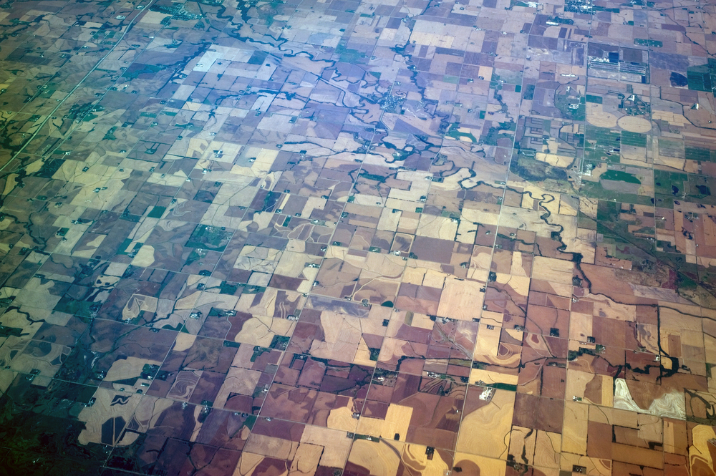
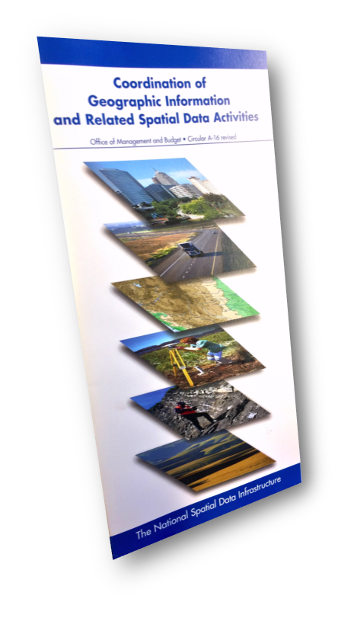
Linking Geographic Information
Policy and Procedures
Public Laws
Executive Memos
Circulars
Reference Guides
Notes:
The NSDI policy, standards and procedures components are integrated and leveraged to unleash high value datasets for government, commercial and public use.
We have a number of public laws that are issued by our legislative branch (The Congress)
Recent policies and guidance issued through the executive branch (The President) in Open Government, Open Data, and Standards development are accelerating our ability to unleash data.
We have circulars issued by the Office of Management and Budget which provide management and operational guidance to agencies
The FGDC is guided by those policies in the design of programs, activities and technologies and sets geospatial information policy in harmony with overall information policy
As a practice public engagement and community coordination is sought and we work with international organizations such as the Open Geospatial Consortium and the Global Spatial Data Infrastructure Association in the development of standards and procedures.

Slide 10
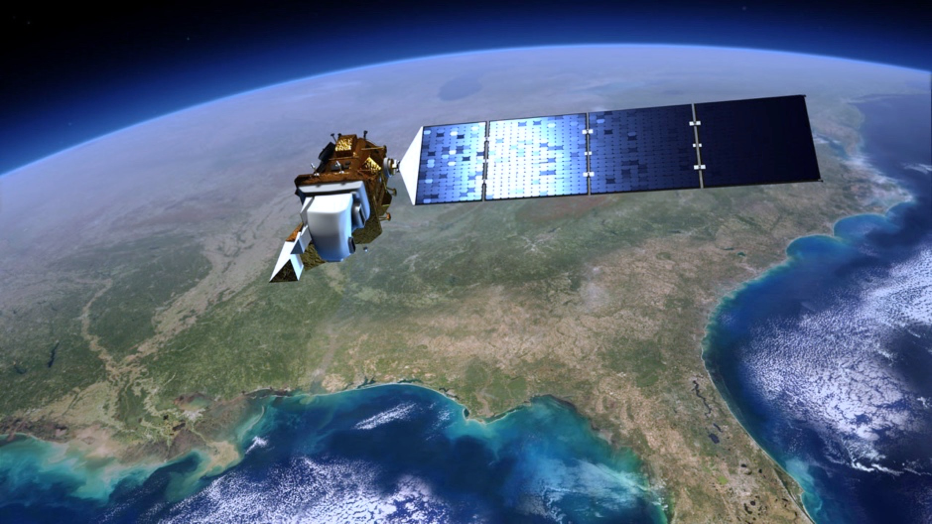
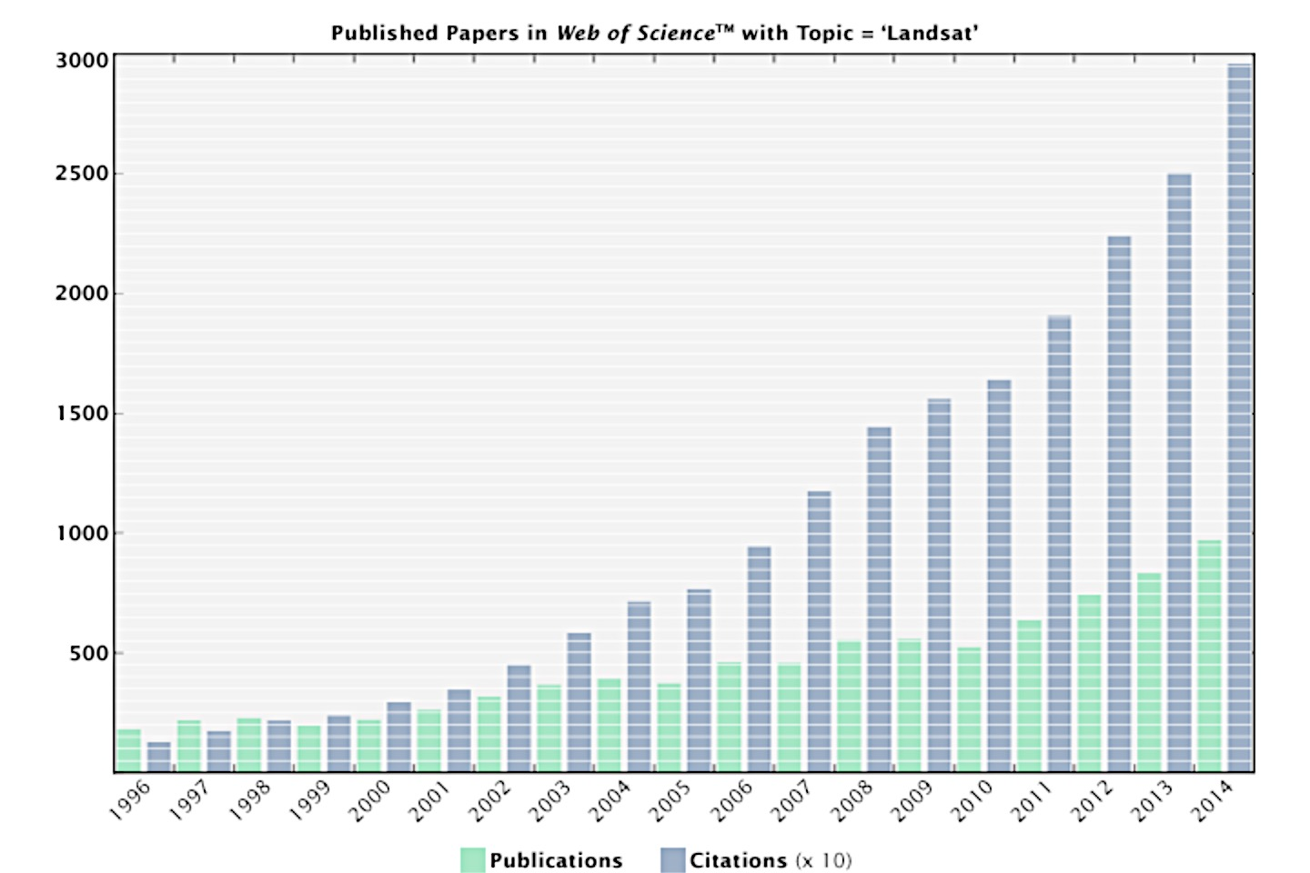
Linking Geographic Information
Open Data Impact on Landsat Services
Annual Economic Benefit
USA $1.70 B
International $400 M
Global Total $2.1 B
.
25,000,000
20,000,000
15,000,000
10,000,000
5,000,000
After Open-Data Policy:
5,700 scenes/day
Free and Open Data
Before Open Government:
53 scenes/day
Downloads
Notes:
Chart Source: http://earthobservatory.nasa.gov/Features/LandsatBigData/
As an example of unleashing data for commercial applications and use:
Since landsat data has been free we have seen a significant increase in:
Number of scenes downloaded per day from 53 – 5,700
Increase in the number of publications
Increase in the number of citations from around 1.5 Million to 2.8 million
Increase in the number of downloads from about a million to over 25 million per year
An economic evaluation identified over $2.1 Billion in economic benefit

Slide 11
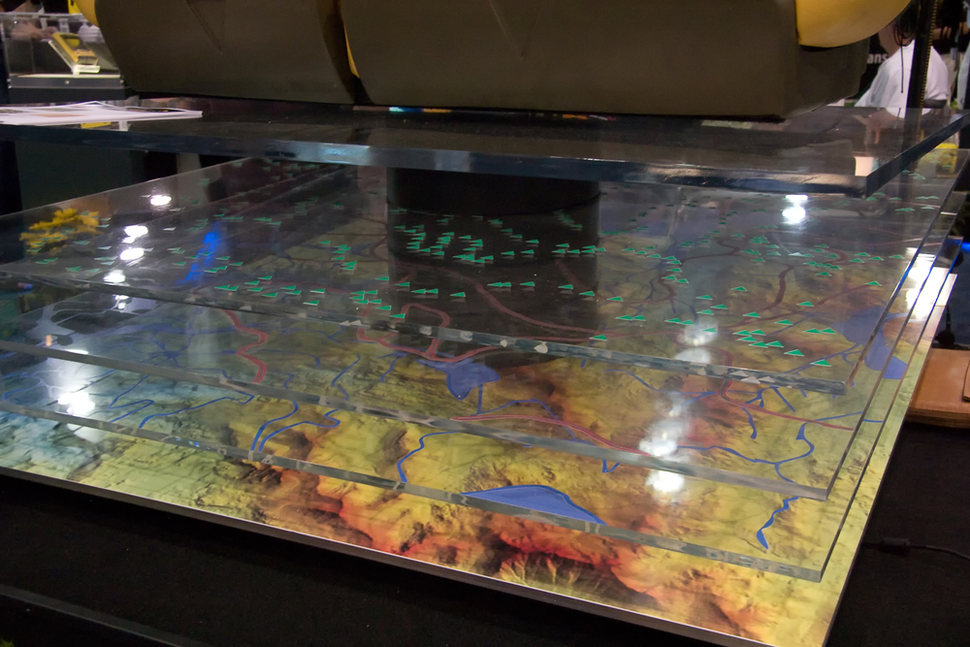
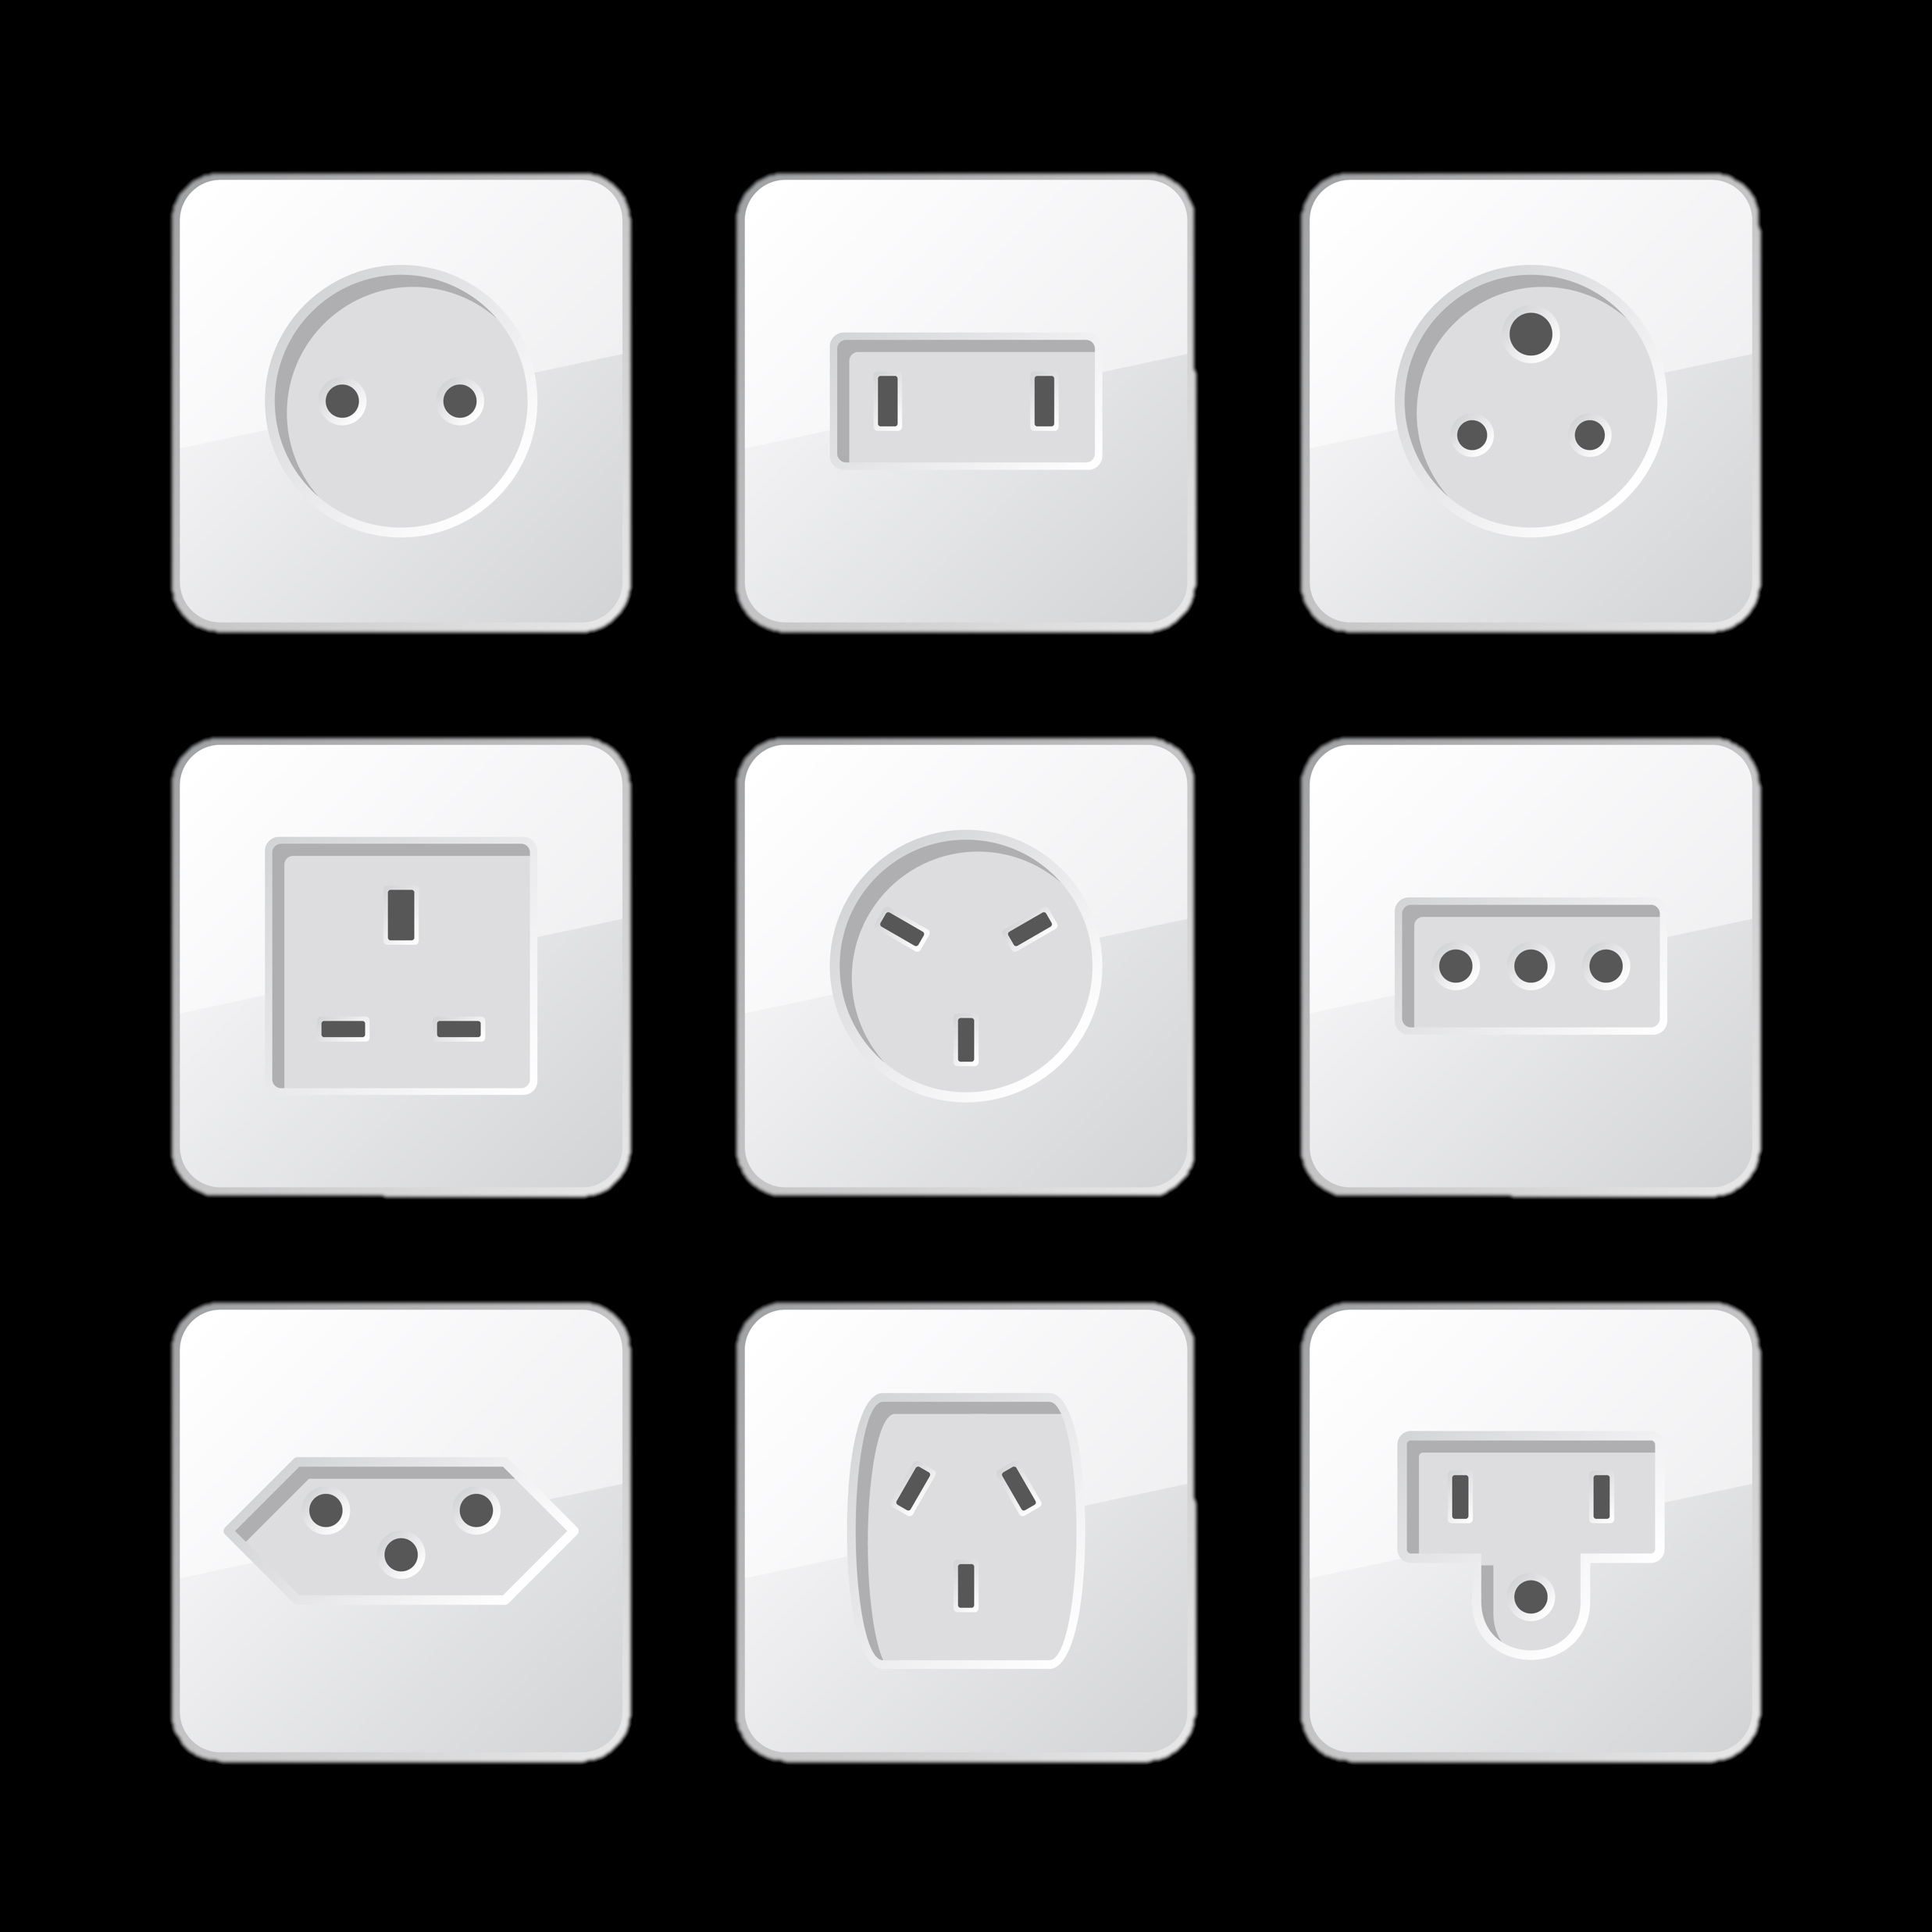
Linking Geographic Information
Standards and Interoperability
Standards facilitate development, sharing, and use of geospatial data and services
1
2
3
4
5
Develop Proposal
Review
Proposal
Setup Project
Produce Working Draft
Review Working Draft
Proposal
Project
Draft
Standards Working Group
Subcommittee/Working Group
Standards Development Group
Subcommittee/Working Group
6
7
Review
10
11
8
9
Review & Evaluate Committee Draft
Approve Standard for Public Review
Coordinate Public Review
Respond to Public Review
Evaluate Responsiveness to Public Comments
Approve Standard for Endorsement
12
Approve Standard for Endorsement
Final
Standards Working Group
Coordination Group
FGDC Secretariat
Standards Development Group
Standards Working Group
Coordination Group
FGDC Steering Committee
Notes:
Standards facilitate development, sharing, and use of geospatial data and services. The FGDC develops or adopts geospatial standards for implementing the NSDI, in consultation and cooperation with State, local, and tribal governments, the private sector and academic community, and to the extent feasible, the international community. The FGDC Standards component process is:
Collaborative (inclusive of Public and Private Partners, Structured, Iterative
And well-documented as you can see on this process diagram.
The FGDC standards development process is modeled after the ISO and the American National Standards Institute standards processes
Federal agencies that collect, use, or disseminate geographic information and/or carry out related spatial data activities are required to follow FGDC standards
The FGDC has established and endorsed over 100 meta-data, data, technology and other national and international standards.

Slide 12
Linking Geographic Information
Data Framework
Notes:
Under the Data component we have established data as a national asset and through our framework we have identified priority assets, established leadership, communities and are implementing portfolio management and reporting to unleash data for commercial use.

Slide 13
Linking Geographic Information
Framework Data
Notes:
The US has established 7 framework data themes that serve as the foundation for the NSDI
We have identified lead agencies who are responsible for developing the NSDI capabilities under each of these framework data elements we are developing strategic and operation plans for accelerating implementation.

Slide 14
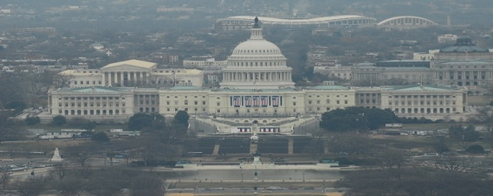
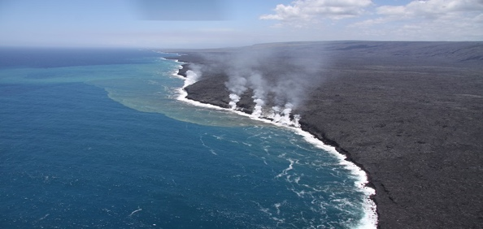
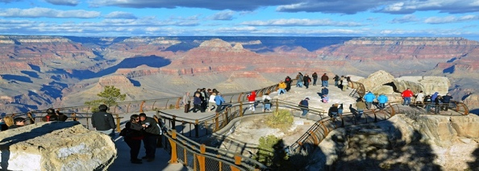
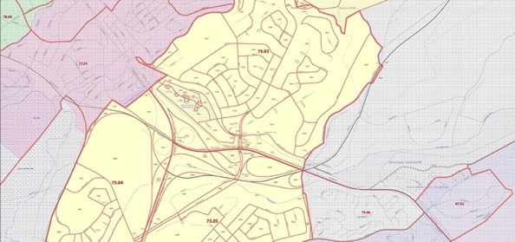
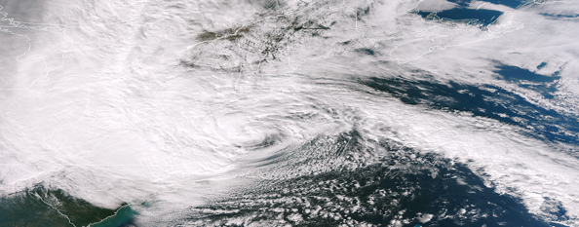
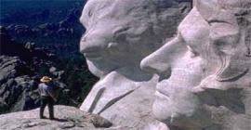
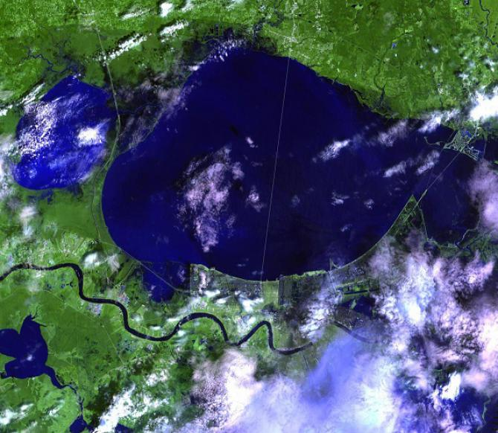
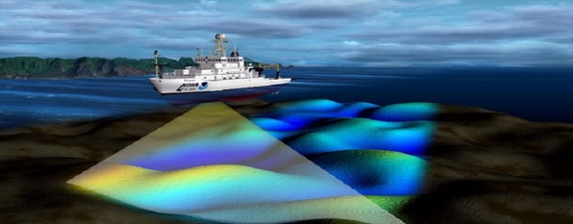
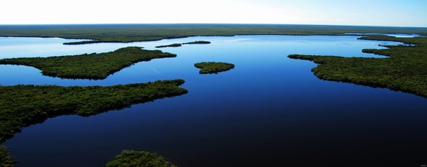
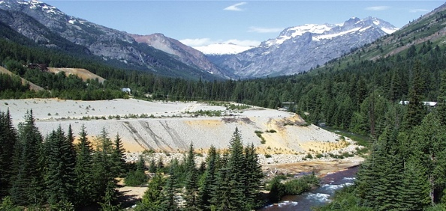
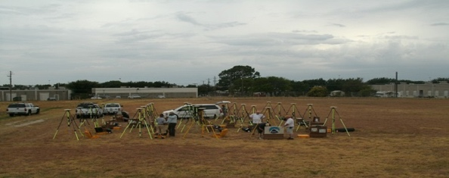
National Geospatial Data Assets Data Themes
Linking Geographic Information
National Geospatial Data Assets Data Themes
Biodiversity & Ecosystems
Real Property
Geology
Cadastre
Soils
Government Units
Climate & Weather
Transportation
Cultural Resources
Imagery
Utilities
Elevation
Water-Inland
Land Use & Land Cover
Geodetic Control
Water – Oceans & Coasts
Notes:
As I mentioned previously our nation has established geospatial data as a national asset. The FGDC established the National Geospatial Data Assets to provide a standard core set of digital spatial information for the Nation that serve as a foundation for users of geographic information. We initially established 32 data Themes but it became clear after a few years that we needed to refine and prioritize our efforts. We have reduced that number to 16 National Geospatial Data Assets

Slide 15
Linking Geographic Information
NSDI Technology Services
The GeoPlatform links and Connects Local-to-Global Data, Information and Knowledge
Notes:
Our ability to implement the NSDI vision was limited in previous decades because the technical capacity and capabilities were not feasible. Over the past five years with partner cooperation we prototyped and piloted cloud services as a flexible scalable resource to support the NSDI vision. We have many success stories and as a result we have established the Geospatial Platform in the cloud.
The Geospatial Platform is envisioned to provide:
Local-to-global access to data, information and knowledge resources
Tools for visualization, synthesis and analysis
Services for acquiring and delivering geospatial information and services
Collaboration tools and services for government, commercial and public use

Slide 16
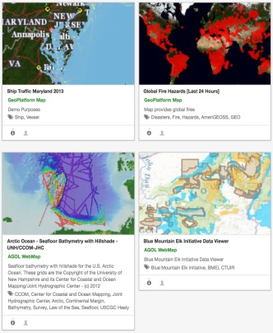
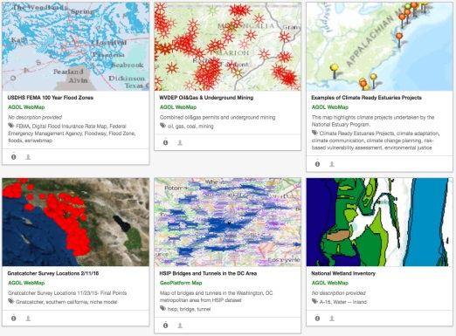
A Spatial Framework for the Location-Based Digital Ecosystem
The GeoPlatform links and Connects Local-to-Global Data, Information and Knowledge
Welcome to the Geospatial Platform
The GeoPlatform provides shared and trusted geospatial data, services, and applications for use by the public and by government agencies and partners to meet their mission needs.
GeoPlatform users have access to
A one-stop shop that delivers trusted, consistent data and services
Authoritative data to support informed decision making
Reusable applications and services for governmental and nongovernmental use
A shared infrastructure that can host your data and applications
A focal point where governmental, academic, private, and public data can be visualized together to inform national and regional issues
Geospatial Platform Services
Data Services
Applications & Tools
Shared Services
Communities
Notes:
The GP links connects local to global data, information and knowledge
Through the GP we have established a service catalog that provides data, applications, tools, shared services and community resources to advance the use of geographic information for understanding and decision-making

Slide 17
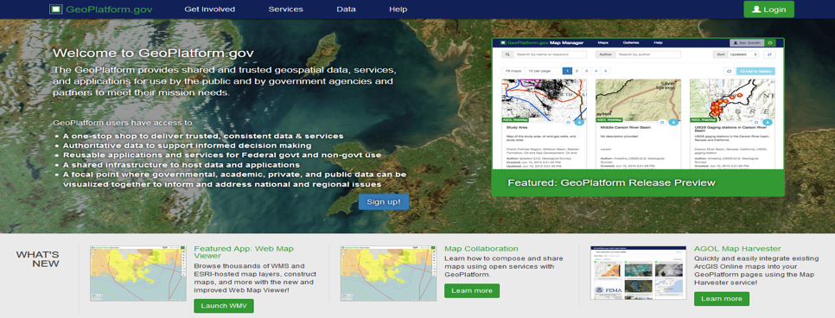
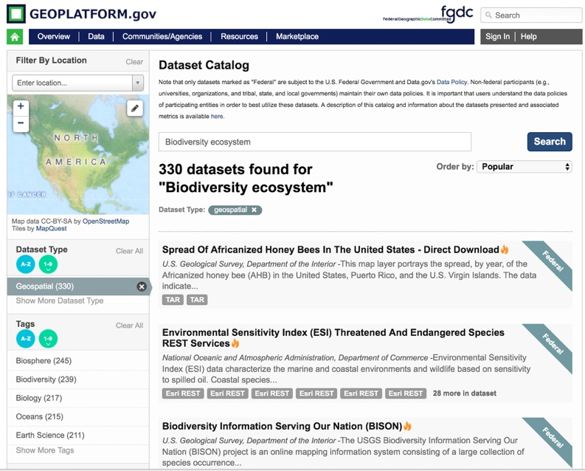
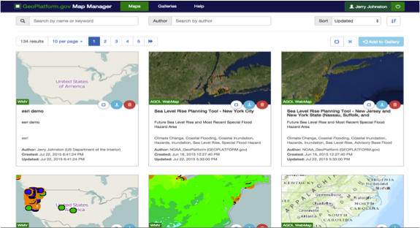
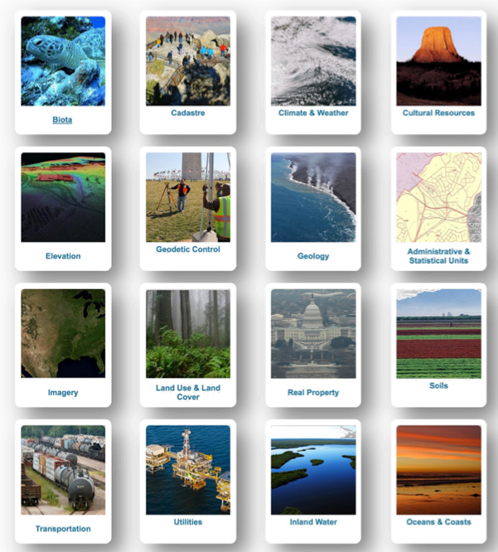
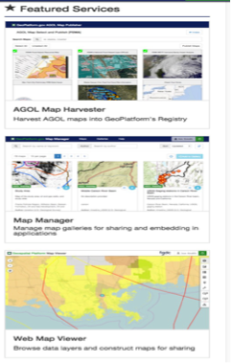
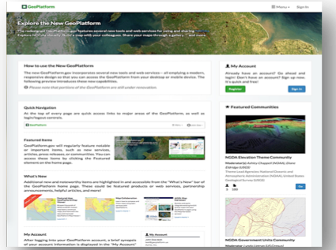
Linking Geographic Information
Geospatial Platform Services
Notes:
The platform provides an abundance of resources and services and serves as a crowing achievement for the FGDC.
The GeoPlatform contains:
130,000 datasets accessible through open standards
Tools that provide over 16,000 social, economic and environmental map data layers
Consumers can access a growing inventory of thematic and topical visual data maps that have been created by governmental, commercial, academic and public participants
The Marketplace is a maturing service that supports economically efficient access for data acquisitions.
GIS monitoring provides reliability information of provider services
Collaboration communities facilitate sharing of data, maps and more
These are just a few examples from the GeoPlatform. The evolution of the GeoPlatform integrates the 6 NSDI framework components and is the maturing realization of the NSDI vision.

Slide 18
Beyond Data–Analytics and Understanding
A Spatial Framework for the Location-Based Digital Ecosystem
Welcome to the Geospatial Platform
The GeoPlatform provides shared and trusted geospatial data, services, and applications for use by the public and by government agencies and partners to meet their mission needs.
GeoPlatform users have access to
A one-stop shop that delivers trusted, consistent data and services
Authoritative data to support informed decision making
Reusable applications and services for governmental and nongovernmental use
A shared infrastructure that can host your data and applications
A focal point where governmental, academic, private, and public data can be visualized together to inform national and regional issues
Map Manager
Map Viewer
Marketplace
Data Acquisition
Service Dashboard
Community
Knowledge Base
Performance Dashboard
The GeoPlatform provides a suite of applications and tools for integrating, synthesizing, analyzing problem-solving and visualizing geographically enriched data to accelerate understanding and decision-making.
Applications & Tools
Notes:
The GP provides users interactive applications and tools to perform useful tasks that exploit shared National geospatial data
A few examples include:
Visualization tools allow users to develop products that improve understanding
Marketplace and data acquisition resources support economies of scale
Data Lifecycle management resources and health analytics access the health of resource

Slide 19
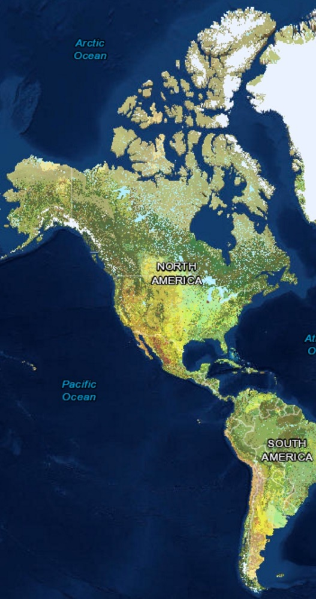
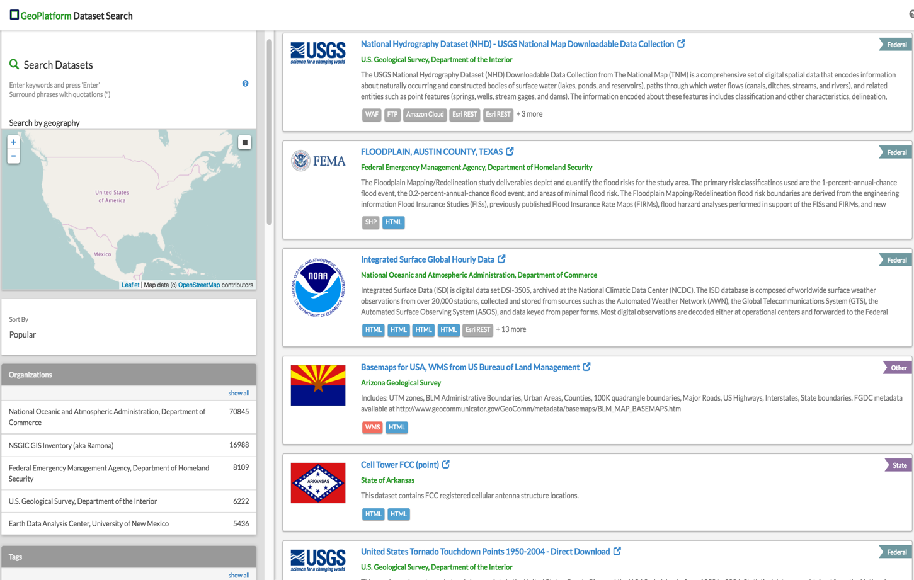
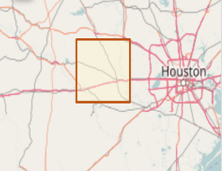
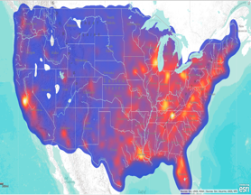
A Spatial Framework for the Location-Based Digital Ecosystem
Use
Search
Water Availability
Find
Flood Planning
Climate Forcasting
Land Management
Communications
The GeoPlatform delivers trusted, nationally consistent, authoritative, geographically enriched social, economic, environmental and other data for understanding and decision making.
Data Services
DATA
Notes:
The GeoPlatform delivers trusted, nationally consistent, authoritative geographically enriched social, economic, environmental and other data for data driven decision making using locational analytics.
Researchers, Analyst, resource managers and decision makers can use GP data to support analysis, planning, forecasting, and development of products and services.

Slide 20
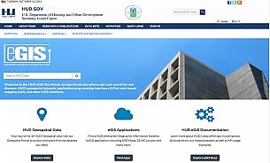
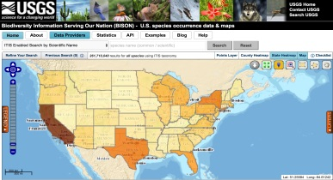
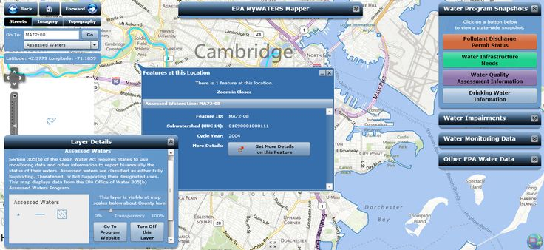
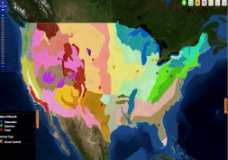
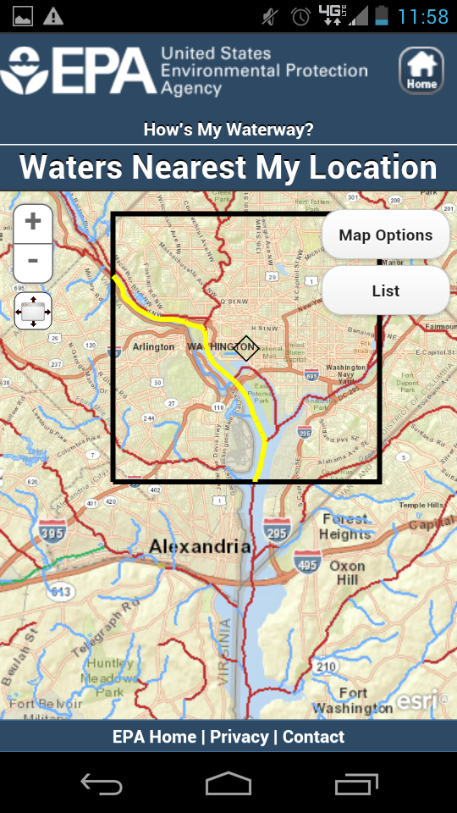
A Spatial Framework for the Location-Based Digital Ecosystem
Welcome to NEPAnode an application to inform project planning, siting, and analysis of the potential social, environmental and resource impacts under the National Environmental Policy Act(NEPA).
The GeoPlatform provides shared hosting infrastructure that allows agencies to publish their geospatial data, applications, and tools in a secure cloud-computing environment at a low cost.
Shared Services
DATA
Notes:
Over the past 5 years we have conducted 37 pilot projects in the cloud and launched cloud platform services in 2016 for mission areas.
A few examples shown here include national water quality, housing and urban planning, environmental protection and biodiversity and ecosystem health.
We currently offer:
Infrastructure, Platform, and software as a service through Amazon Web Services and ESRI.

Slide 21
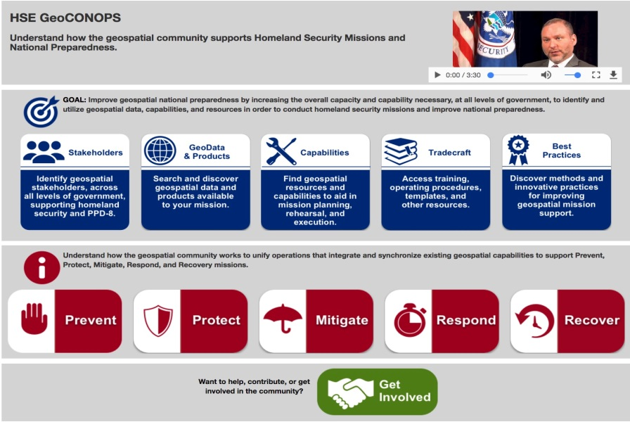
A Spatial Framework for the Location-Based Digital Ecosystem
Biodiversity & Ecosystems
Cadastre
Climate & Weather
Cultural Resources
Elevation
Geodetic Control
Geology
Administrative & Statistical Units
Imagery
Land Use & Land Cover
Real Property
Soils
Transportation
Utilities
Inland Water
Oceans & Coasts
The GeoPlatform provides collaborative tools and social resources to advance the use of geospatial resources by communities to achieve measurable results.
Communities
Notes:
Our community resources help thematic communities leverage geospatial data to develop applications, tools, products and services that support understanding and decision-making. As an example our Homeland security and national preparedness community have established a collaboration resource to plan for and respond to a national disaster.

Slide 22
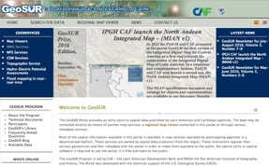
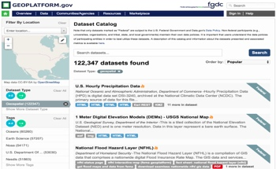
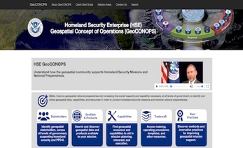
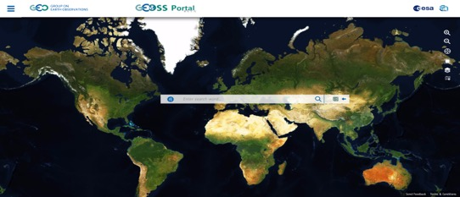
Linking Geographic Information
International Collaboration
ARCTIC SDI
GeoSUR
Regional
GLOBAL Earth Observation System of Systems (GEOSS)
Data Catalog
Tools
Products
Services
Communities
National
Local | State | Tribal | Federal | Academia | Professional
Global
Global
22
Notes:
The NSDI partnership has contributed to national, regional and international SDI Platform development and sustainment efforts. Examples include the U.S. Platform, the Artic SDI, GeoSur and to GEOSS through the group on Earth Observations.
Mateusz Hordjk from your staff participated in our GEOSS architecture efforts this year.

Slide 23
Linking Geographic Information
Opportunities for Cooperation
Linked Data
Lessons Learned and Best Practices
Architecture and Standards
Open Data
Joint Research and Development
Notes:
We have identified additional opportunities for collaboration that include:
Knowledge transfer on lessons learned, best practices, architecture, standards, advancing open data and joint research and development on regional and global activities like GEOSS

Slide 24
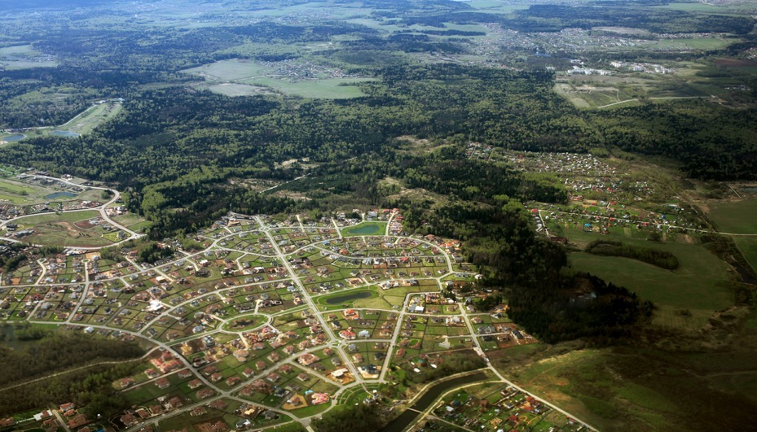
Linking Geographic Information
QUESTIONS?
Partnerships
Policies
Standards
Procedures
Data
Contact: FGDC@FGDC.gov
Technology
National Spatial Data Infrastructure
The NSDI Provides a framework of polices, standards, procedures, data and technology to support the effective coordination and sharing of spatial information among a community of stakeholders.
Notes:
This completes my presentation on US efforts to establish a National spatial data infrastructure. I hope you found this information helpful and I am happy to answer any questions you may have.

