Slide 1
The State of the NGAC 2011
National Geospatial Advisory Committee
March 17, 2011
Dr. David Cowen, Chair
Dr. Jerry Johnston, Vice-Chair
National Geospatial Advisory Committee

Slide 2
Chair’s Personal Introduction
Why are we here?
How did we get here?
Who are we?
What have we accomplished?
What’s on our agenda?
Who is Cowen ?
What are my personal issues and objectives?
Lets’ not forget parcels!

Slide 3
NGAC Purpose
will provide advice and recommendations on federal geospatial policy….
Under FACA rules, will function solely as an advisory body …. on the development of the National Spatial Data Infrastructure (NSDI).
*NGAC Charter

Slide 4
NGAC Mission
To provide strategies regarding the creation, management and dissemination of cohesive geospatial data, ….
* Adopted by NGAC, June 2008

Slide 5
Strategic Vision
"The Nation and its citizens value and are empowered by geospatial resources"
* Adopted by NGAC, January 2009

Slide 6
How did we get here?
OMB A16 - 1953
Clinton Executive Order – 1994
  NSDI
FGDC Governance Review – 2005

Slide 7
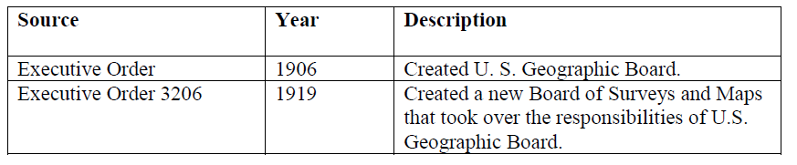
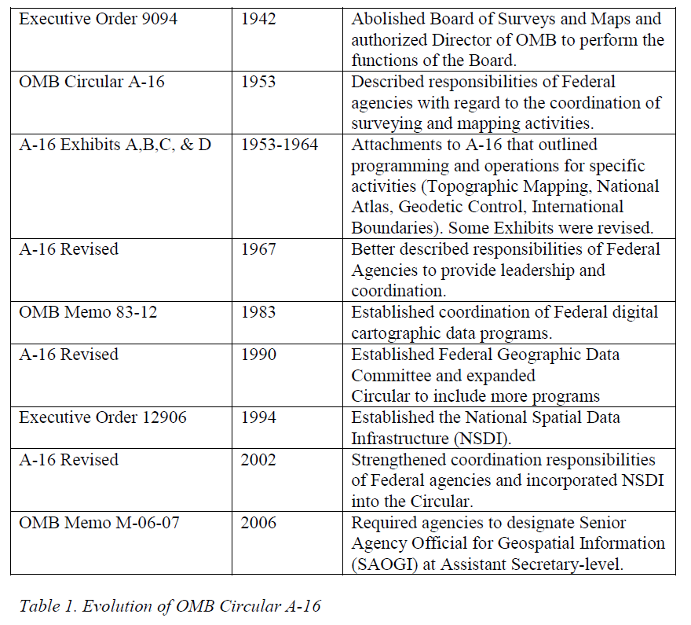
Evolution of OMB A-16
(Milo Robinson )

Slide 8
1994 President Clinton - Coordinating Geographic Data Acquisition and Access: NSDI
“The FGDC shall seek to involve State, local, and tribal governments in the development and implementation of the initiatives contained in this order.
The FGDC shall utilize the expertise of academia, the private sector, professional societies, and others as necessary to aid in the development and implementation of the objectives of this order.”

Slide 9
Executive Order 13563
January 2011
THE WHITE HOUSE Memo February 28, 2011
“With agencies that administer overlapping programs, collaborate with State, local, and tribal governments to standardize, streamline, and reduce reporting and planning
requirements …
Facilitate cost-efficient modernization of State, local, and tribal information systems, drawing upon the collaboration of the Chief Information Officer in the OMB and the Chief Technology Officer in the Office of Science and Technology Policy.”

Slide 10

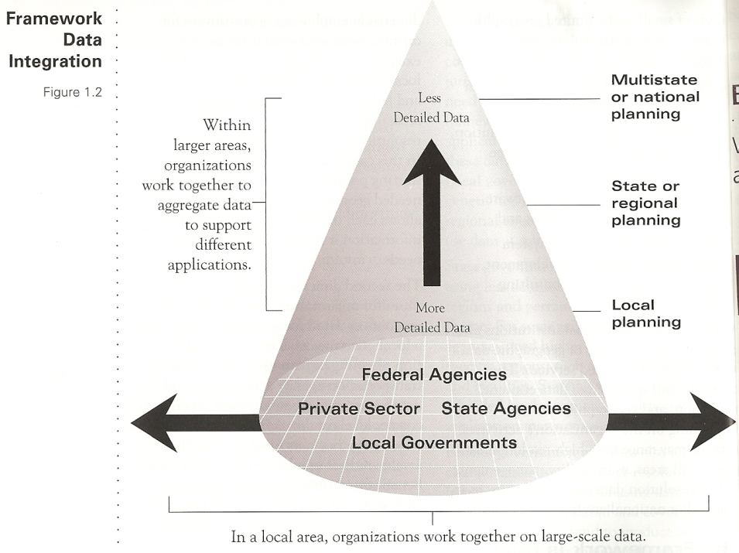
Framework 1997

Slide 11
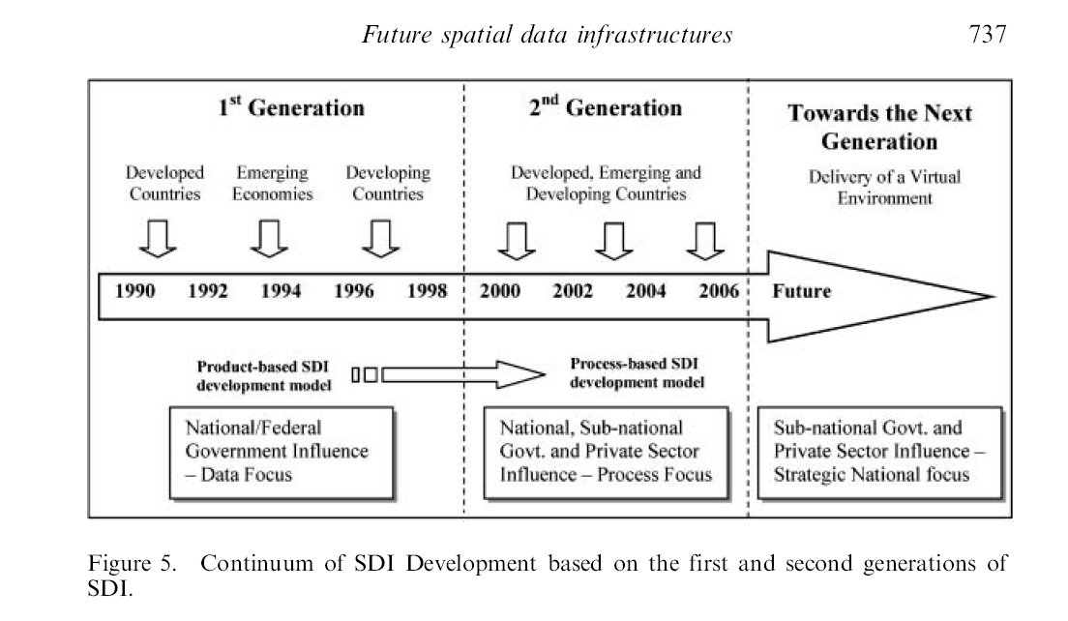
Next Generation SDI
Rajabifard, A., A. Binns, I. Masser, and I. Williamson. 2006. The role of sub-national government and the private sector in future spatial data infrastructures. International Journal of Geographical Information Science 20(7):727 – 741.

Slide 12
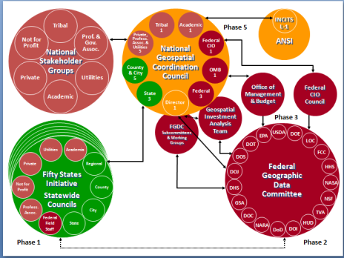
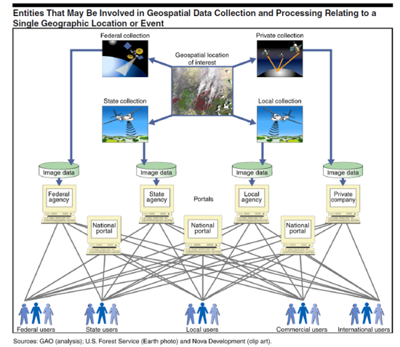
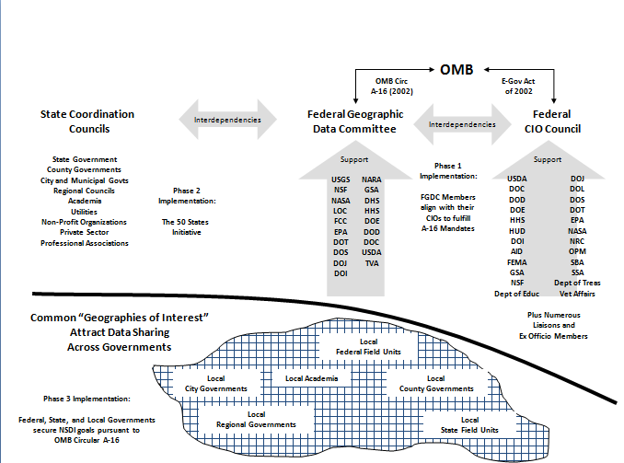
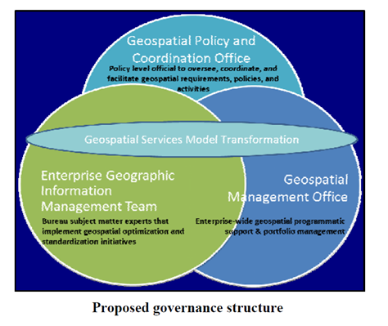
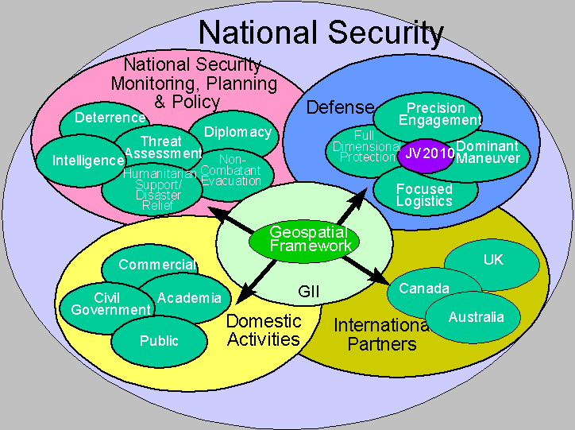
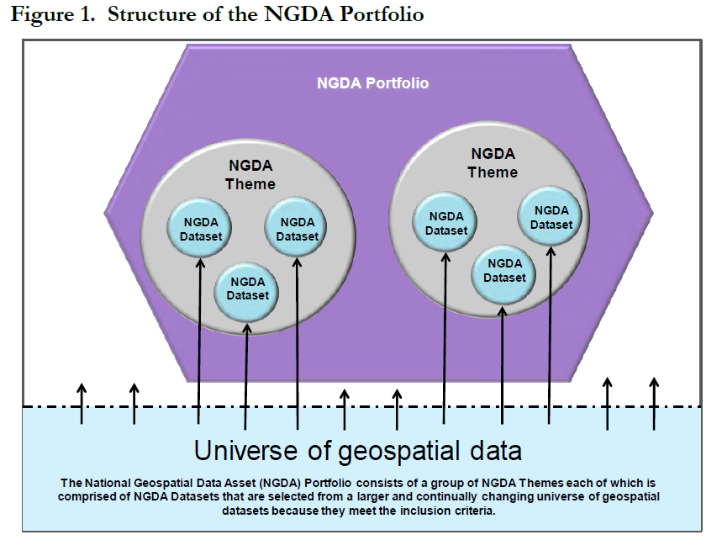
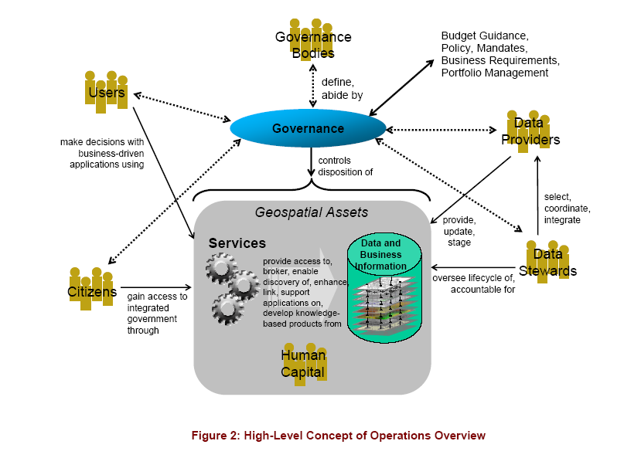
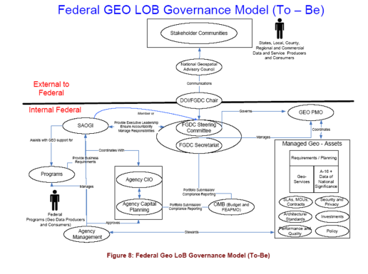
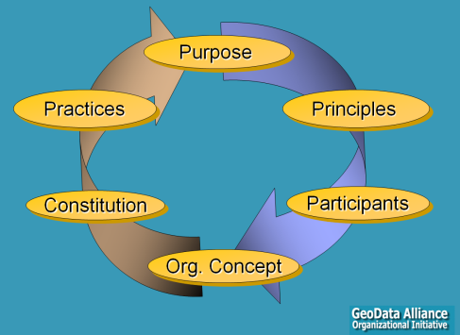
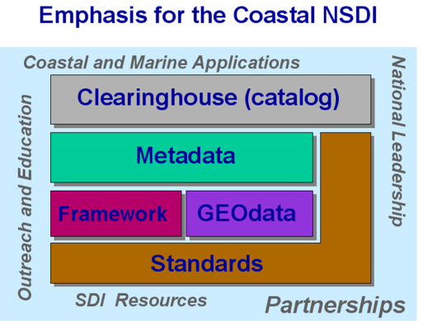
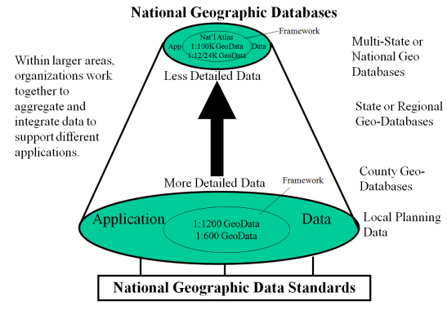
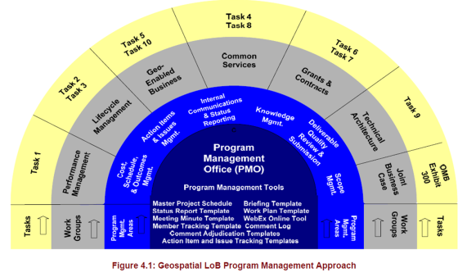
Lots of Governance Models

Slide 13
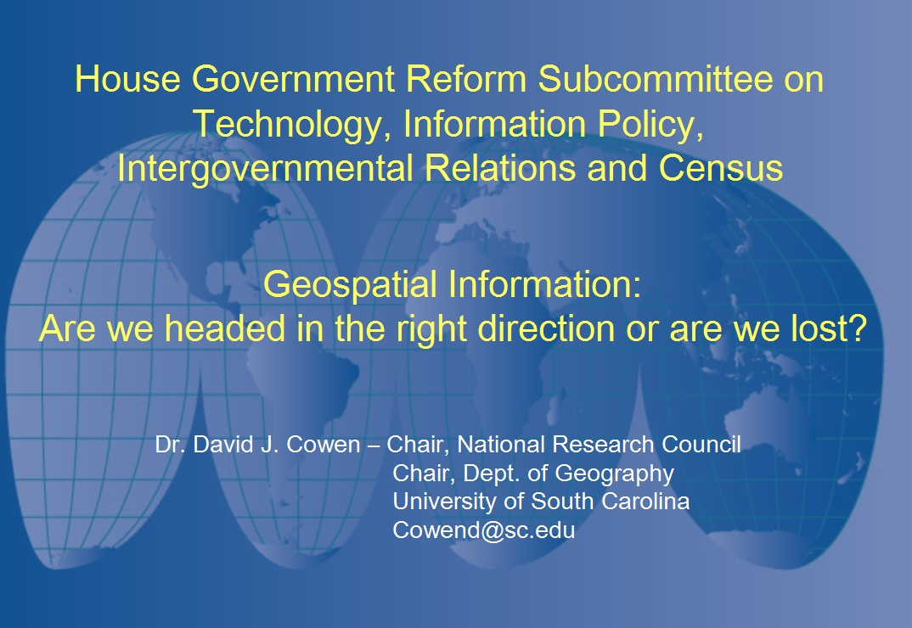
2003

Slide 14
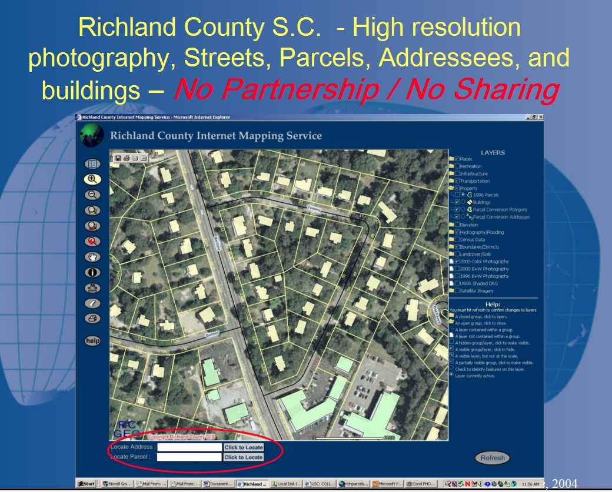

Slide 15
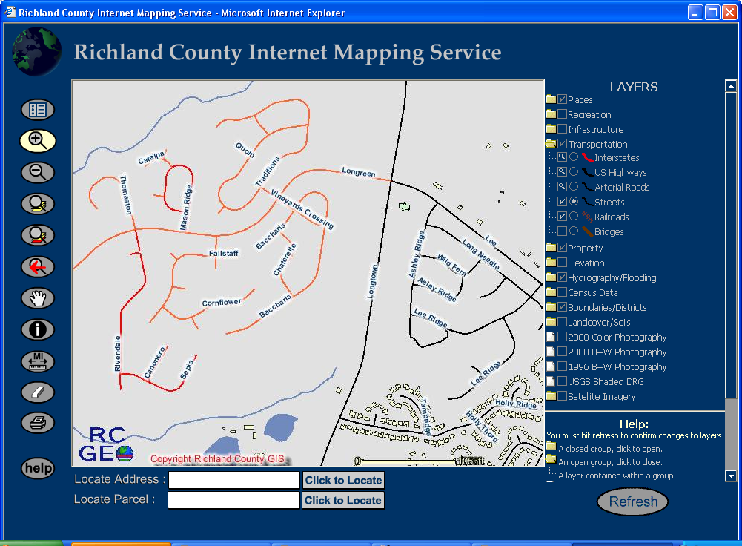
What every first responder (and the Census) should have – But Won’t!!!
(The Census will have to spend taxpayer money to duplicate this data!)
Approved Roads
Existing Roads
Submitted Roads

Slide 16
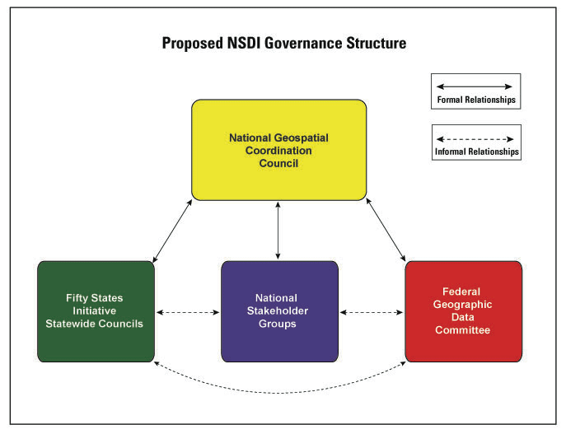
Proposed NSDI Structure - 2005
“Establishing a National Geospatial Coordination Council (NGCC) composed of government and non-government representatives”

Slide 17
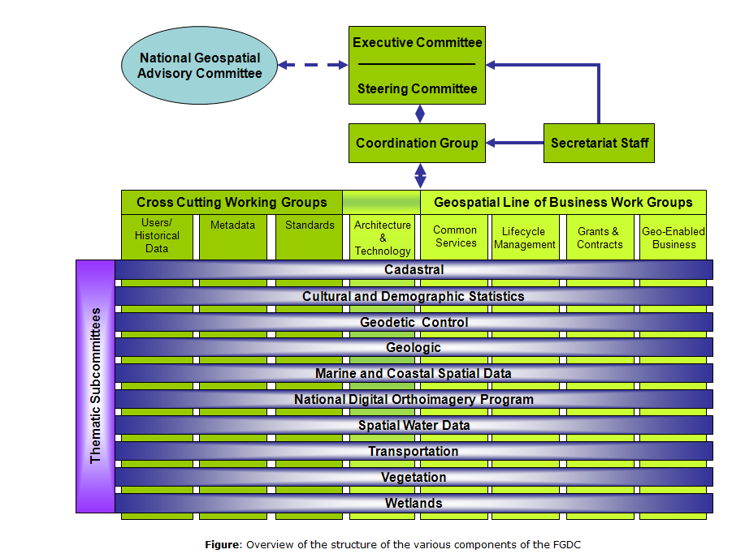
Current Model

Slide 18
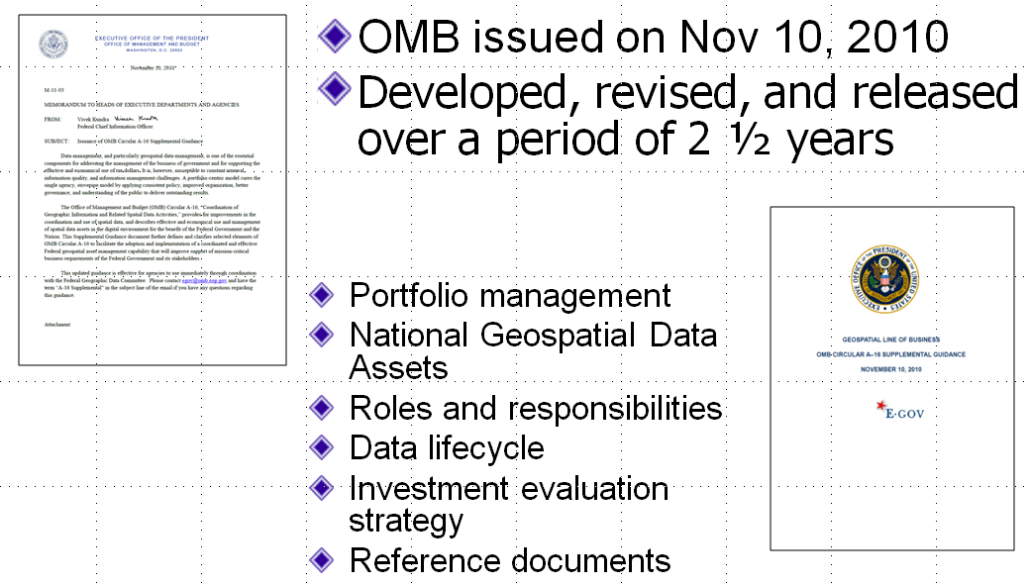
Evolution of OMB A-16
November 2010

Slide 19
Who are we?
13 Public, 10 Private, 3 Academic
David Cowen, Chair University of South Carolina | Randy Johnson Hennepin County, Minnesota | Patrick Olson* Aero-Metric, Inc.
Jerry Johnston, Vice Chair* Environmental Protection Agency | Barney Krucoff District of Columbia | Jack Pellicci Intergraph Corporation
Robert Austin City of Tampa, FL | Laurie Kurilla* Ventura County, CA | Mark Reichardt* Open Geospatial Consortium
Sophia Beym State of New Mexico | Xavier Lopez Oracle USA | Cynthia Salas CenterPoint Energy
Richard Clark* State of Montana | E. Donald McKay* State of Illinois | Eugene Schiller S.W. Florida Water Management District
Jack Dangermond* ESRI | Anne Hale Miglarese*, Booz Allen Hamilton | Anthony Spicci* State of Missouri
David DiSera EMA, Inc. | Kimberly Nelson Microsoft Corporation | Gary Thompson* State of North Carolina
Joanne Irene Gabrynowicz* University of Mississippi | Timothy Nyerges* University of Washington | Gene Trobia* State of Arizona
Kass Green Kass Green & Associates | Matthew O’Connell* GeoEye | David Wyatt* Eastern Band of Cherokee Indians
 | *New Appointees – February 2011 | Ivan DeLoatch NGAC Designated Federal Officer (DFO) Federal Geographic Data Committee

Slide 20
Where do we come from?

Slide 21
How are we organized?
Subcommittee | Chair(s) | Status
Intergovernmental - Geo Platform | Johnston | Active
Geospatial Workforce | DiSera/Ahearn | Active
Emerging Technologies | Nelson/Lopez | Active
Partnerships | Johnston/Schiller | Hiatus
Communications | Green | Hiatus
The National Map | Carroll | Hiatus
Parcel Data | Cowen | Hiatus
GIS Best Practices – Local Gov’t | Krucoff/Austin | Completed
Governance | Goreham | Completed
Economic Stimulus | Nelson | Completed
Transition | O’Connell | Completed
Vision | Nagy | Completed
Changing Landscape | Cowen | Completed
Mission | Krucoff | Completed
Notes:
Examples of the subcommittees and task teams established over our 3-year history

Slide 22
What have we accomplished ?
Created a visible, high level forum
Developed effective operational procedures & subcommittees
Gotten the attention of the administration
Focused on actions to address key issues
Generated valuable products

Slide 23
What have we accomplished ?
Built a strong foundation for the NGAC
  Adopted the NGAC Bylaws
  Created the NGAC Mission Statement
  Crafted and approved NGAC Strategic Vision
Original Guidance
  Formed Subcommittees to address guidance
  Endorsed
    Recommendations on Parcels
    FGDC Record of Decision on IFTN
    Provided feedback / advice on The National Map
Made recommendations to FGDC on Economic Stimulus

Slide 24
NGAC Guidance 2008 - 2009
Focus Areas
Advancing the National Spatial Data Infrastructure
  NSDI - Future Roles and Responsibilities of Key Players
Public-Private Partnerships
  Investment Strategy
Management of Federal Geospatial Resources
  OMB Circular A-16
Data Initiatives
  Imagery for the Nation, The National Map, National Land Parcel Data

Slide 25
What have we accomplished ?
Drafted Economic Recovery: Lessons Learned for the Geospatial Community
Reviewed and commented on OMB Circular A-16 Draft Supplemental Guidance
Featured Spotlight Sessions to Understand Critical Issues impacting the Geospatial Community
  Metrics
  Geospatial Platform
  Geospatial Workforce Development
  Interagency Data Sharing & Collaboration

Slide 26
Key NGAC Products
NGAC Transition
Recommendations
Changing Geospatial Landscape
White Paper

Slide 27
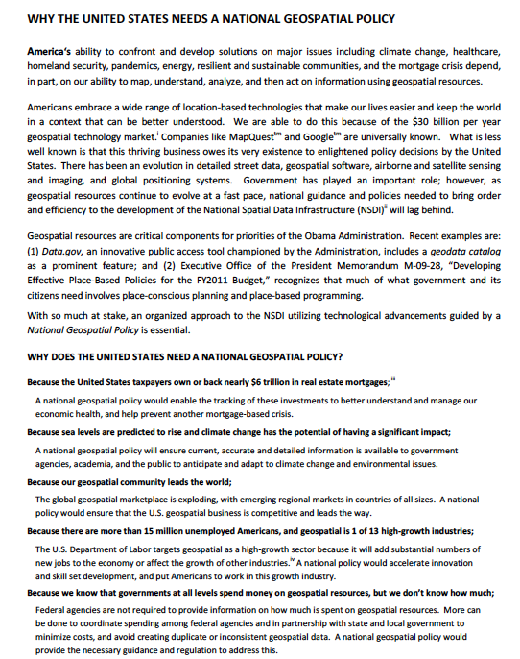

Key NGAC Products
Geospatial Policy Benefits Statement
GIS Best Practices for Local Government

Slide 28
What’s on our agenda ?
Emerging Technologies Subcommittee – Initial focus on Cloud Computing – White Paper on “Geospatial Future”
Geospatial Workforce Subcommittee – Spotlight Session at the December meeting and continuing work
Intergovernmental Subcommittee: Geospatial Platform – Providing ongoing feedback & advice
GIS Best Practices for Local Government and its companion – NGAC’s most recent products
Geolocation Policy – Continuing dialogue

Slide 29
What’s on our agenda ?
Guidance 2011
  Innovative Strategies for Geospatial Programs and Partnerships
  Geospatial Workforce Development
  Emerging Technologies
  Geospatial Partnerships with Tribal Governments
  Feedback on Specific Programs/Initiatives

Slide 30
NGAC Guidance 2011
Focus Areas
  Geospatial Platform
  Place-based Policies
  Emerging Technology
  Broadband Mapping
  Geospatial Workforce
  National Basemap/National GIS
  Partnerships

Slide 31
Approach: NGAC Guidance 2011
Collaboratively frame each focus area through discussions with ExCom and members
Define the scope of each focus area
Develop a strategy to address each focus area - NGAC, research, subcommittee, or task team
Develop a project outline or plan including deliverables and timeframes (later timeframe

Slide 32
Who is Cowen?

Slide 33
Personal Profile
  Research
    First GIS in 1968
    Latest – 3D model of campus
    NASA, DOE, State / Local
  Administration-
    College computing Lab,
    VP for computing,
    Dept Chair (top 10)
  Teaching – 14 PhDs and 50 MS
  Public Policy
    State GIS coordination,
    Mapping Science Committee,
    NGAC

Slide 34
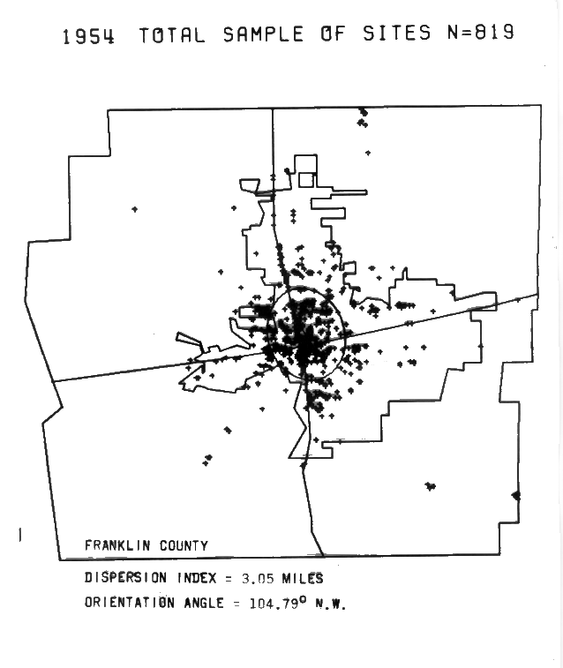
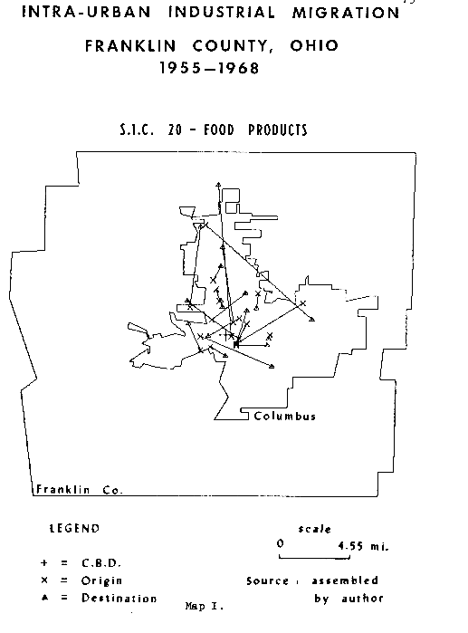
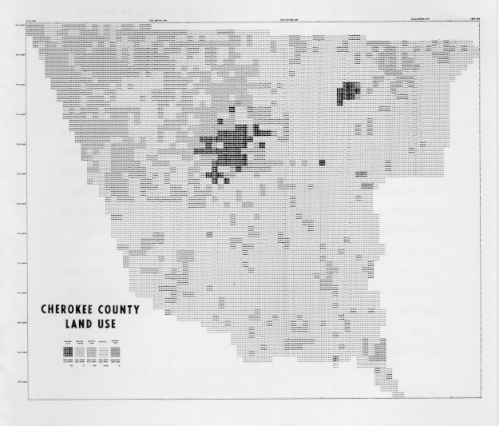
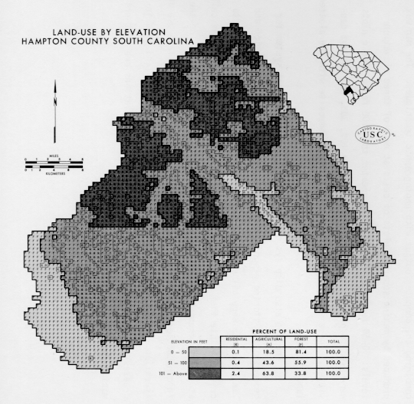
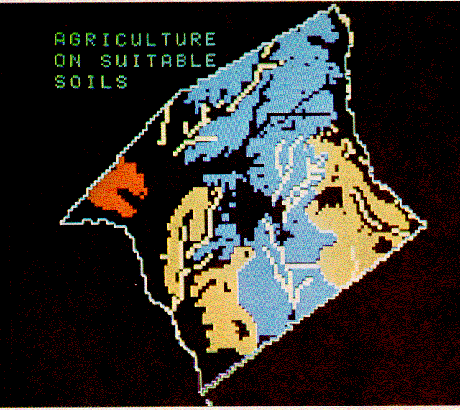
GIS Before Esri
Dissertation
1968
Early 1970’s Land Use

Slide 35
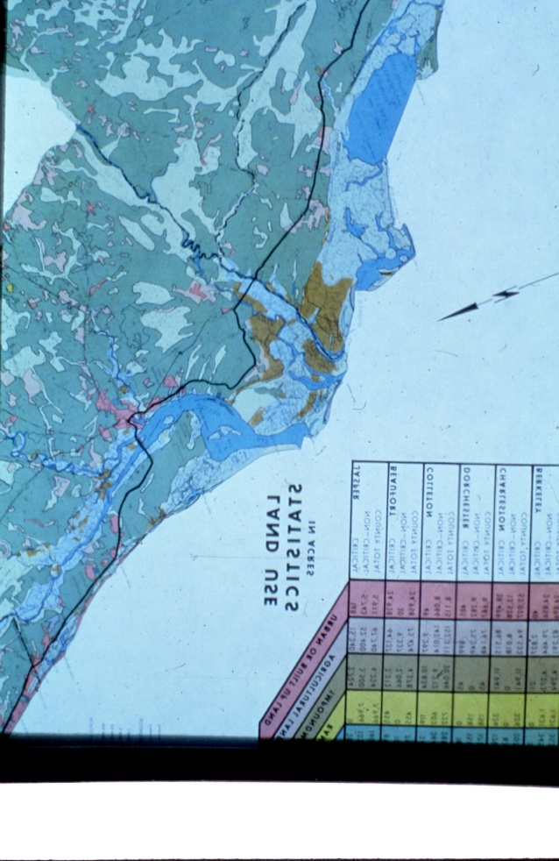
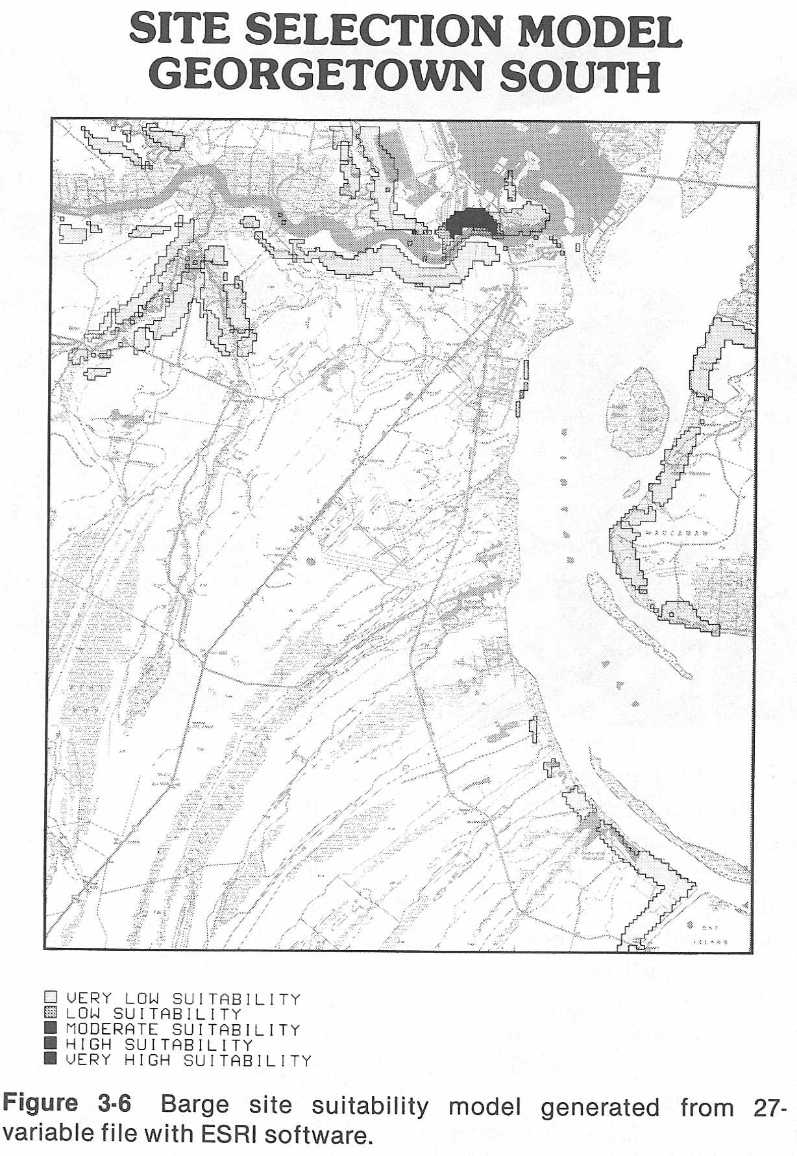
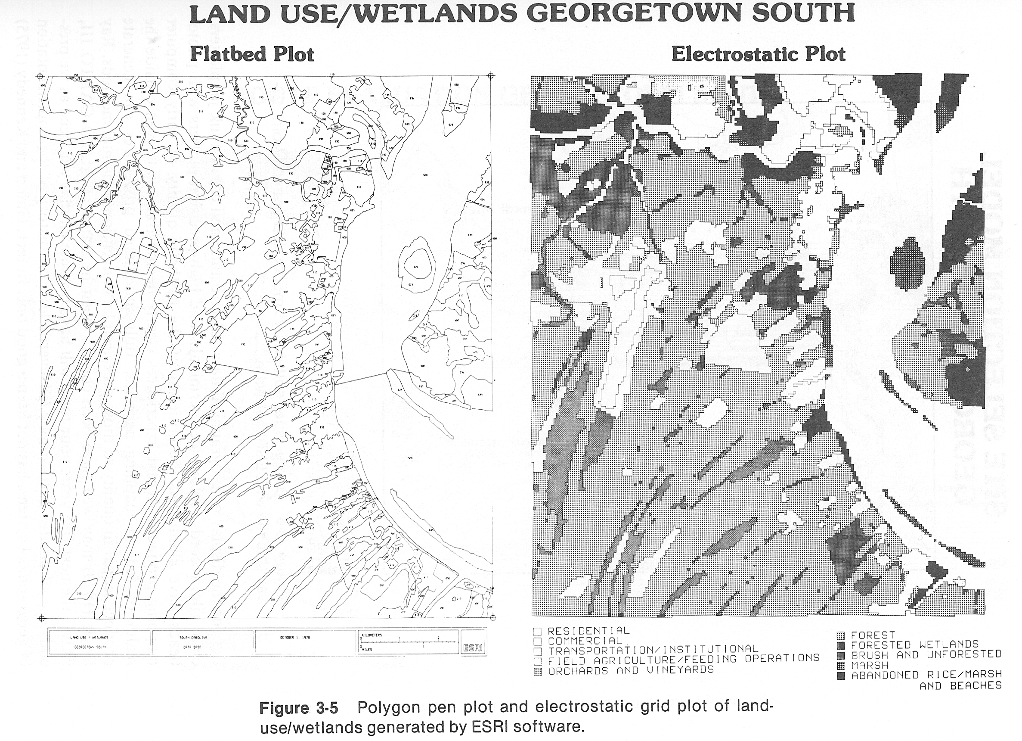
Late 1970’s Coastal Zone Management

Slide 36
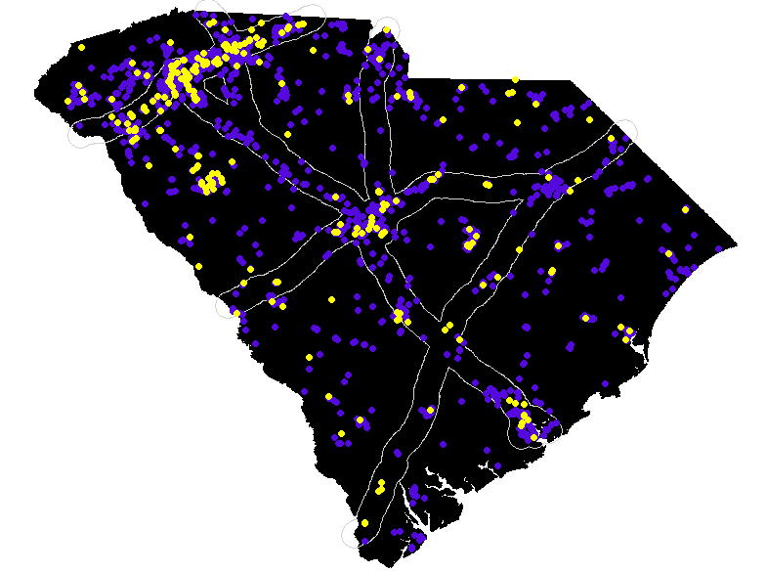
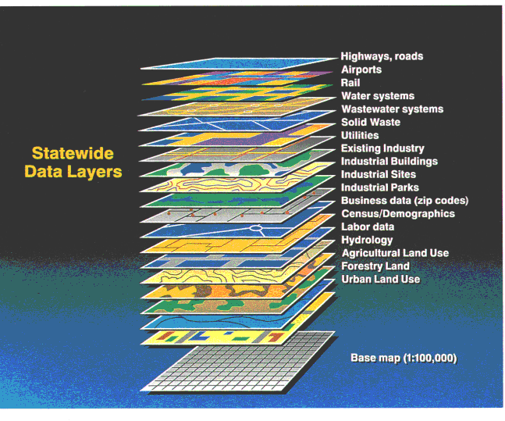
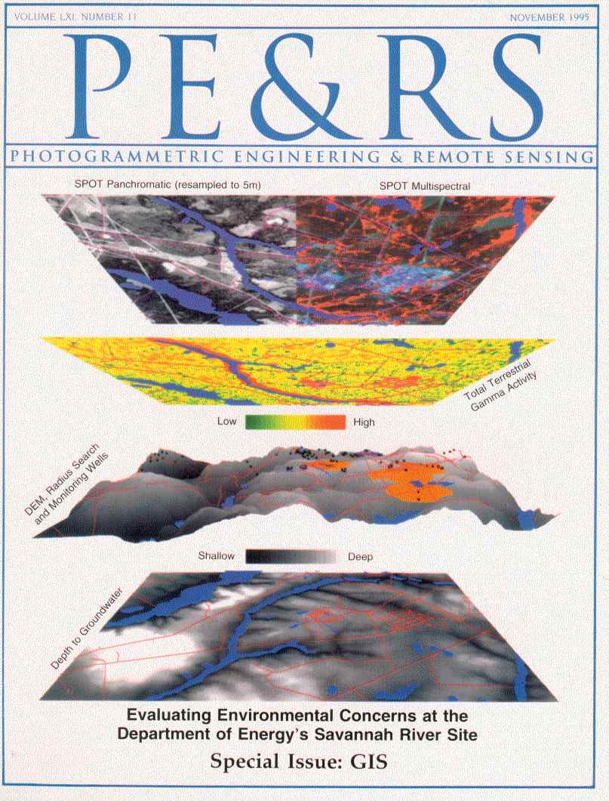
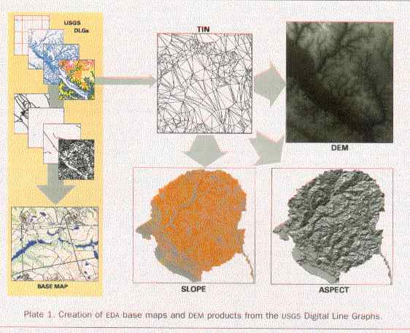
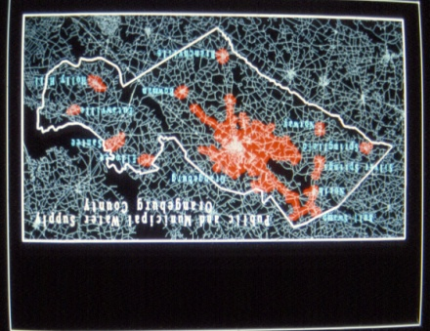
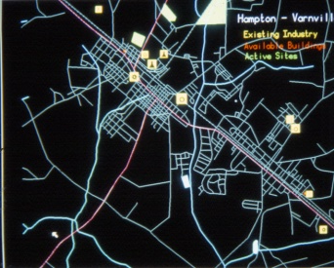
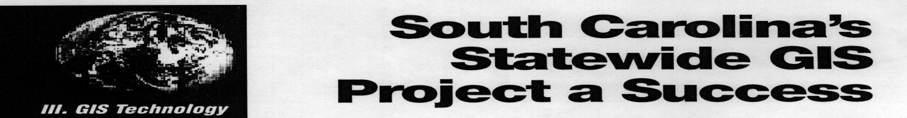
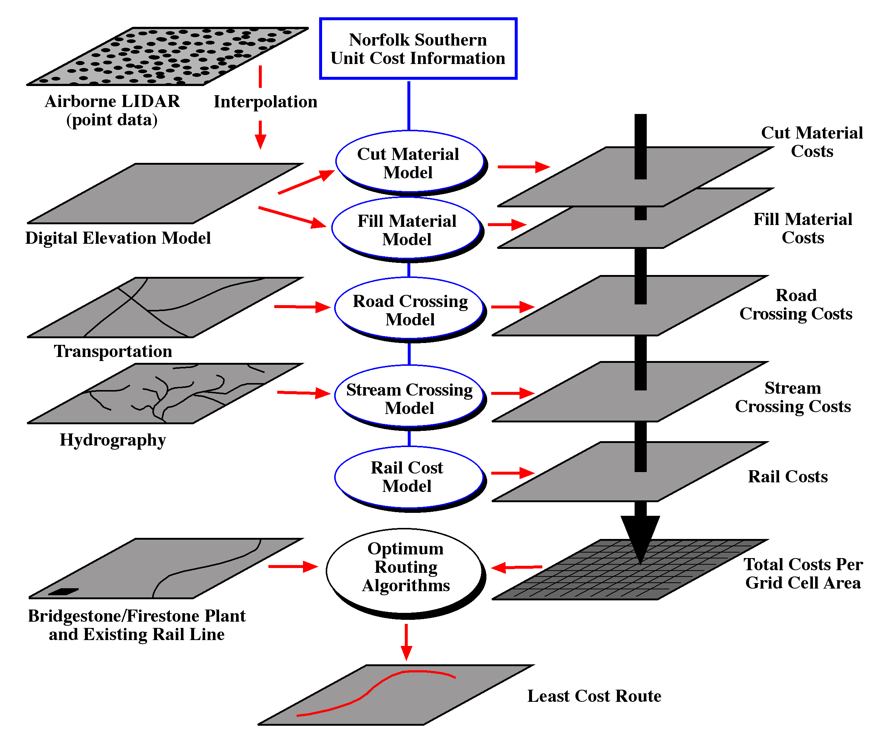
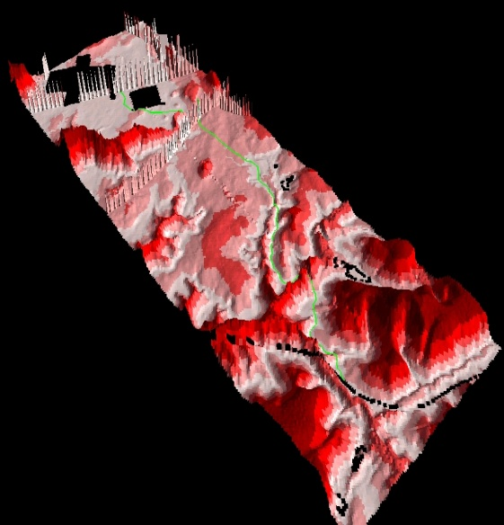
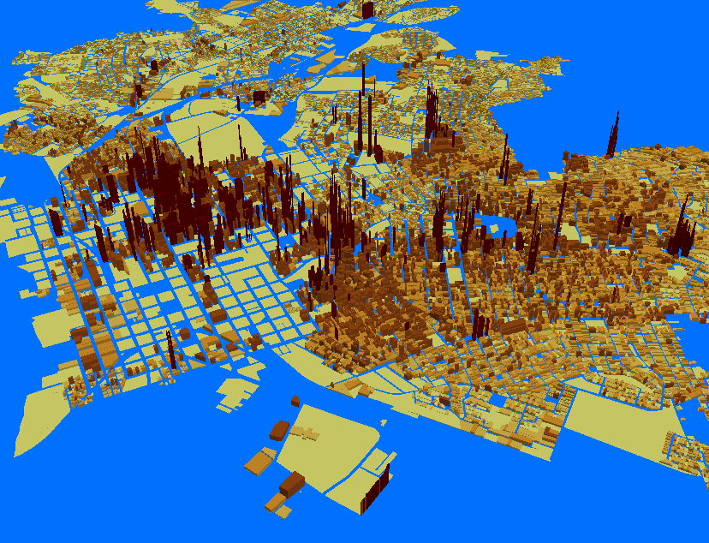
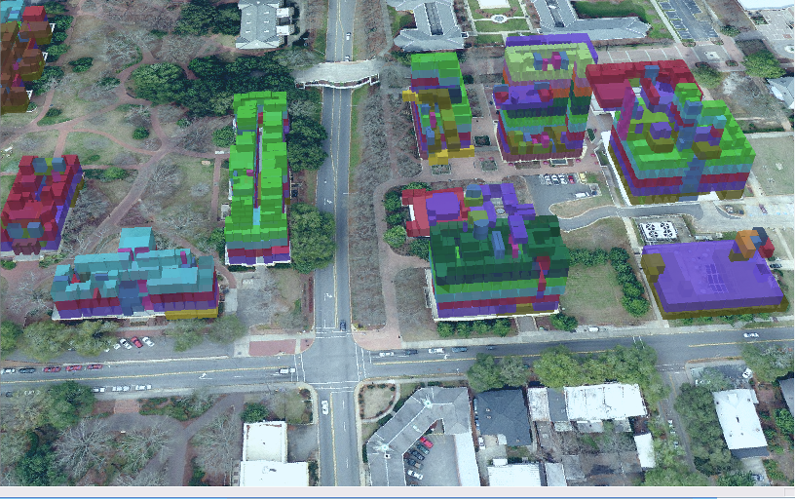
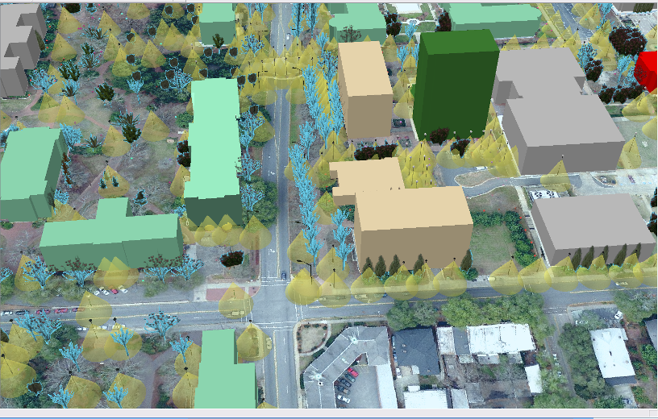
Research Interests
DOE – Environmental Atlas
State – Economic Development
NASA - Commercial Apps
Parcel Level Analysis
Campus 3D models

Slide 37
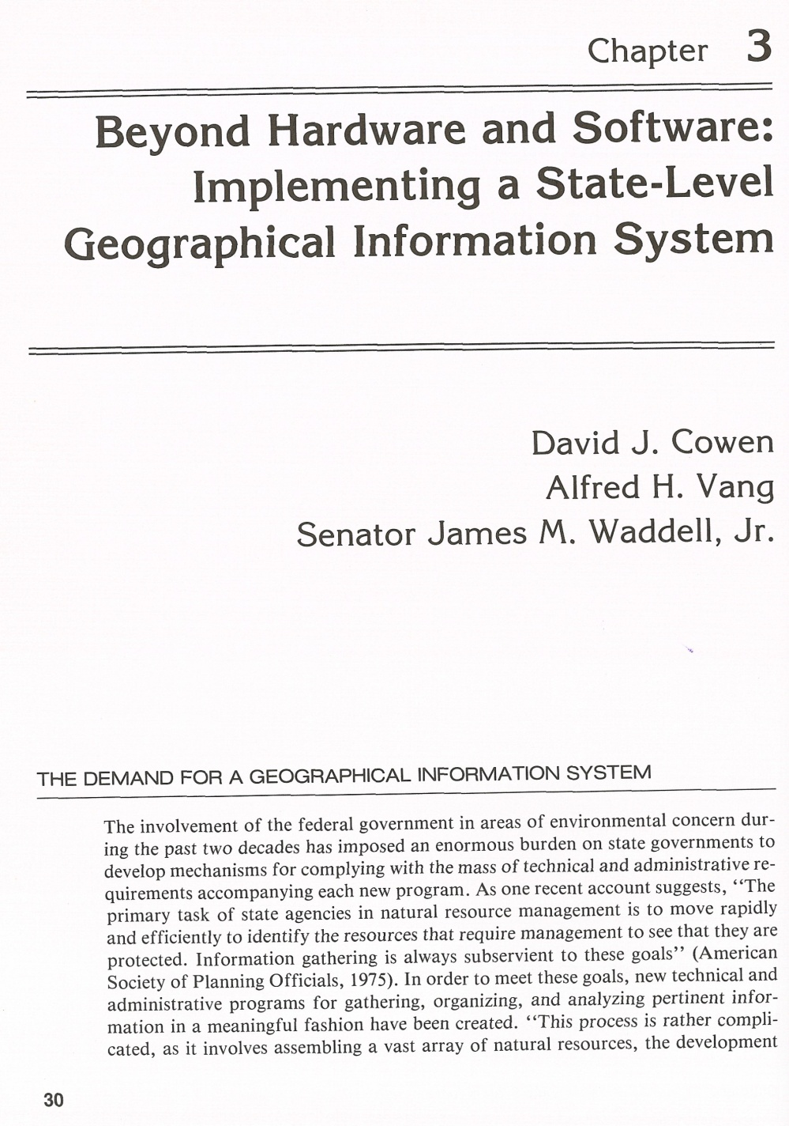

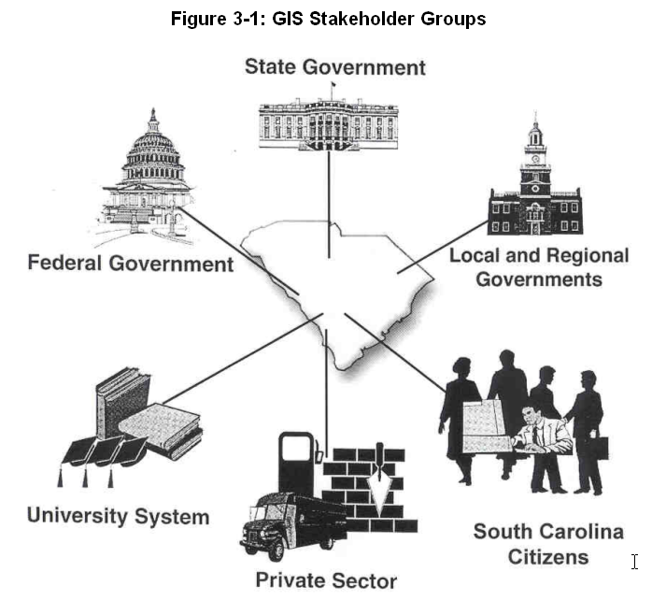
State Coordination 1983 - 2005
1983
2005

Slide 38



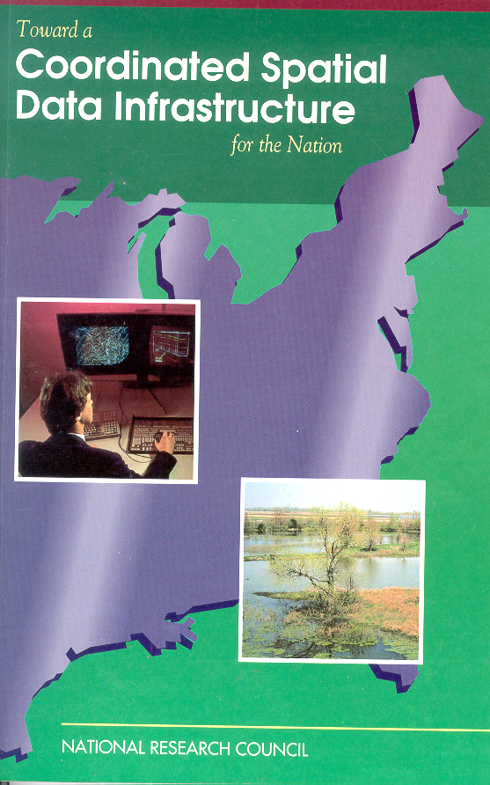




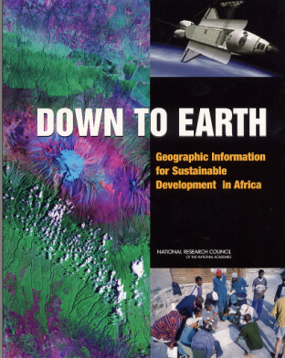


Mapping Science Committee
1990 Pre FGDC
1991 R & D
1993 Defined NSDI
1994 Partnerships
1995 Foundation
2001 Partnership
Programs
1997 Future
2002 State Dept
2003 National Map
2004 Licensing

Slide 39
What are my personal Issues and goals?
Impatient – My last chance
This is my “Day Job”
Resolve tough issues
  Stewardship, Turf, Priorities, Funding
Details not diagrams
Dialog not reports
Acquire and use most appropriate information from the best sources
Discover and evaluate the most appropriate and efficient technology

Slide 40
My Interpretation
We don’t live in a 1:24,000 world
NSDI – Means acquire and use most appropriate data (high resolution and current)
  Local & crowd sourced
The platform/ cloud provide new technology infrastructure
Challenges:
  “It’s easy to make a decision in the absence of information”
  “How do we make geospatial information so accessible that it cannot be ignored?”
-

Slide 41
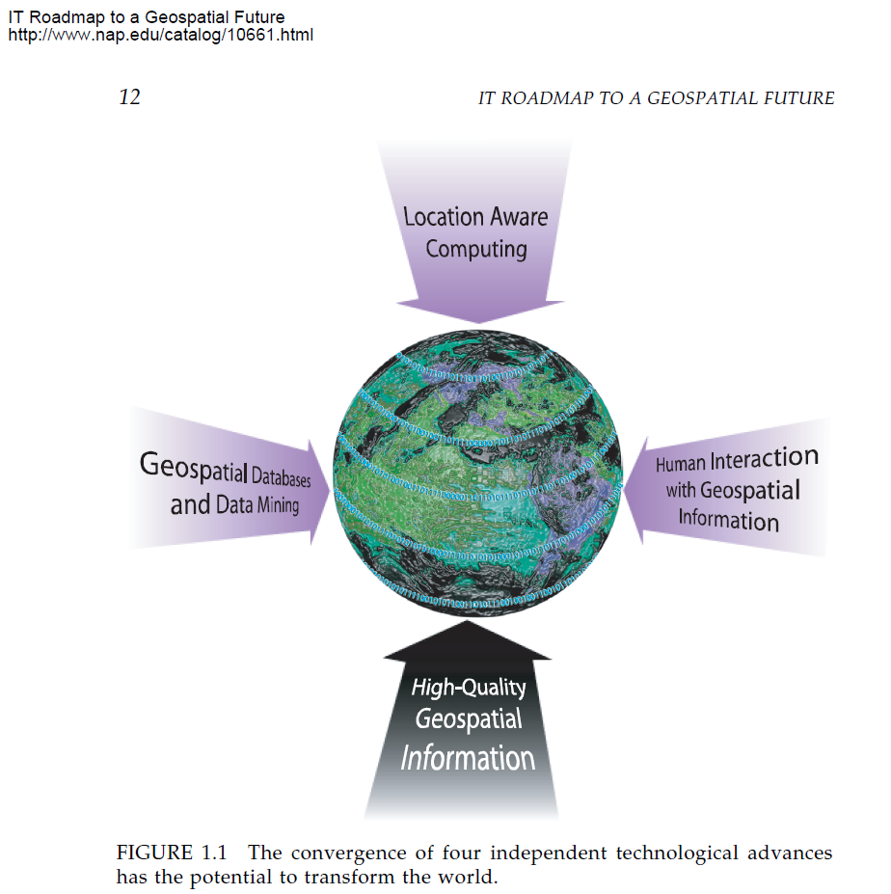
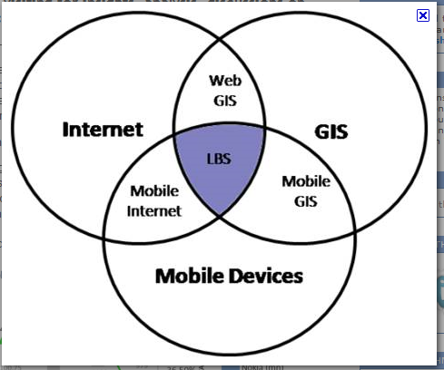
Convergence & New Possibilities
technowizz.wordpress.com/
NRC

Slide 42
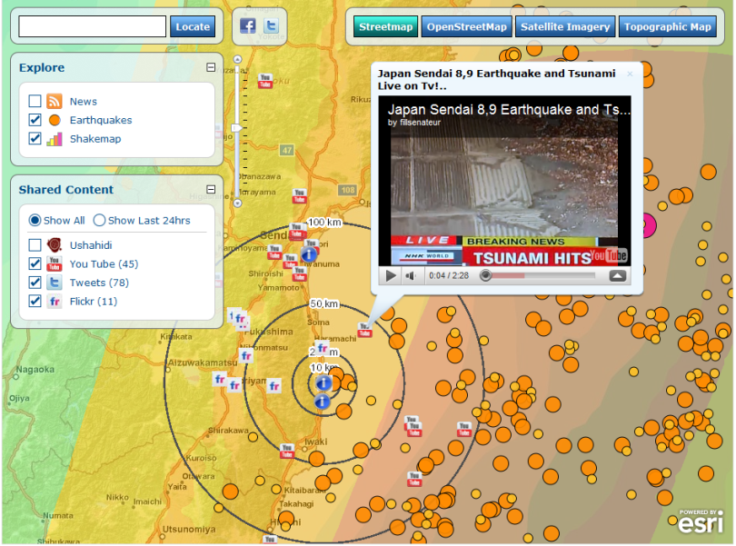

Modern view – Two NGAC Members
Social Media – Live Geotags
Current – High Resolution Imagery

Slide 43



Virtual Charlotte

Slide 44

Cities Have There Own App Stores

Slide 45



State Portals

Slide 46


Lets Not Forget Parcels !!
NGAC Endorsement of
9 Recommendations

Slide 47

Congressional Research Service

Slide 48


2009 FGDC Annual Report
”The feature story of this year’s report underscores the need for a coordinated system of land parcel information across the country.”

